Slide 1
Exploring the efficiency of mapReduce approaches through Different use cases
Mohamed Derri
Salah Eddine Ait Daoud

Slide 2
AGENDA
Introduction
Map Reduce Algorithms and Results
Conclusion
Spark
Conclusion
Summary

Slide 3
INTRODUCTION
A Comparative Study of Word Count and Average Computation using MapReduce and InMapper Combining
Efficient Frequency Computation with Hadoop: Comparing the Pair and Stripe Approaches for Improved Time and Memory Performance

Slide 4
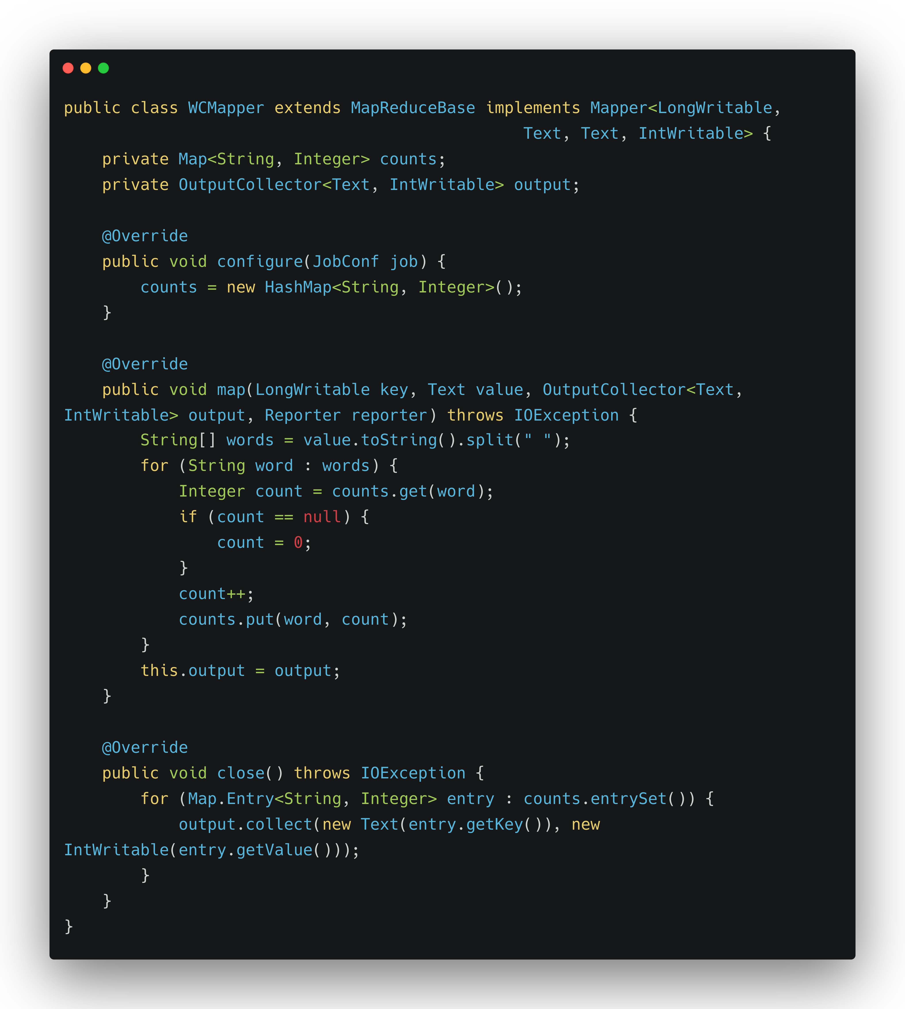
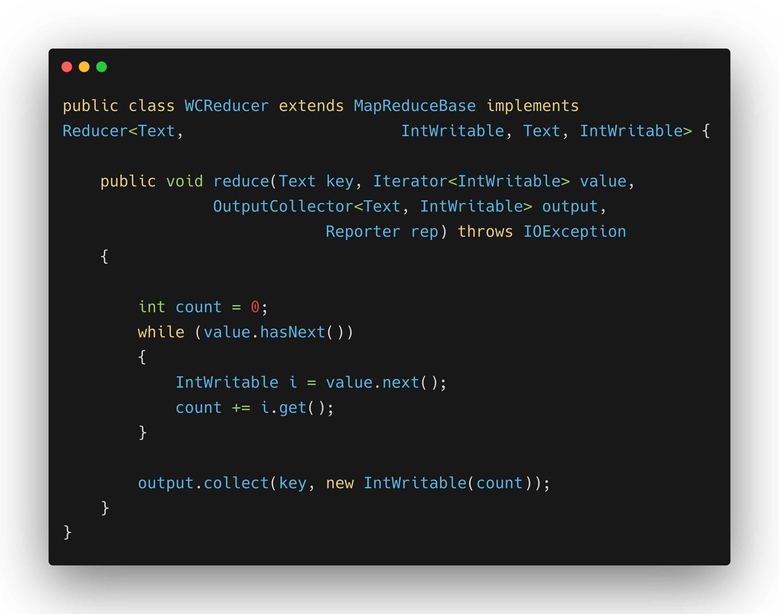
In-Mapper Combining Word Count java Implementation

Slide 5
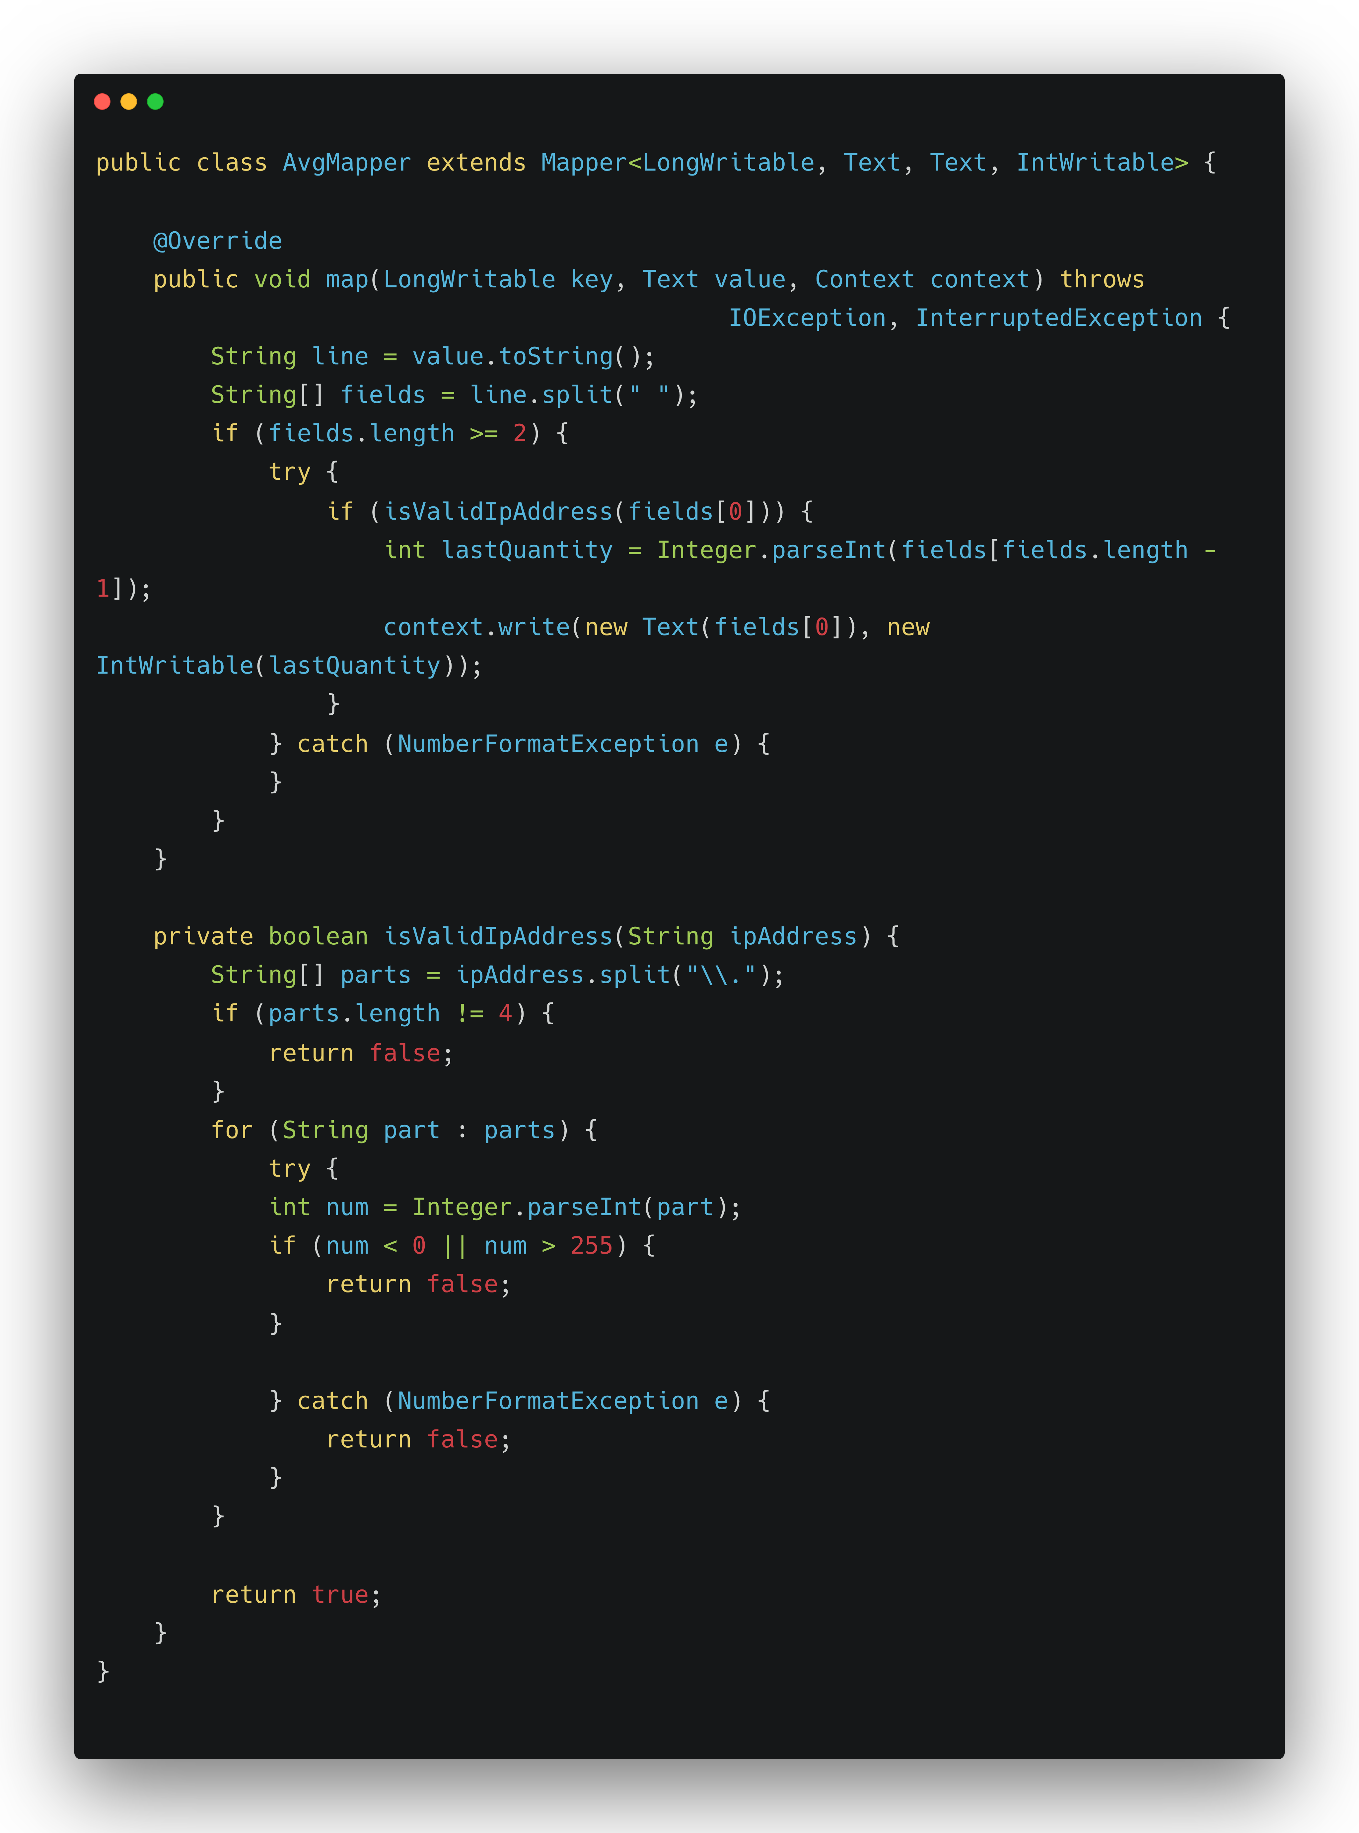
MapReduce Average
Java Implementation

Slide 6
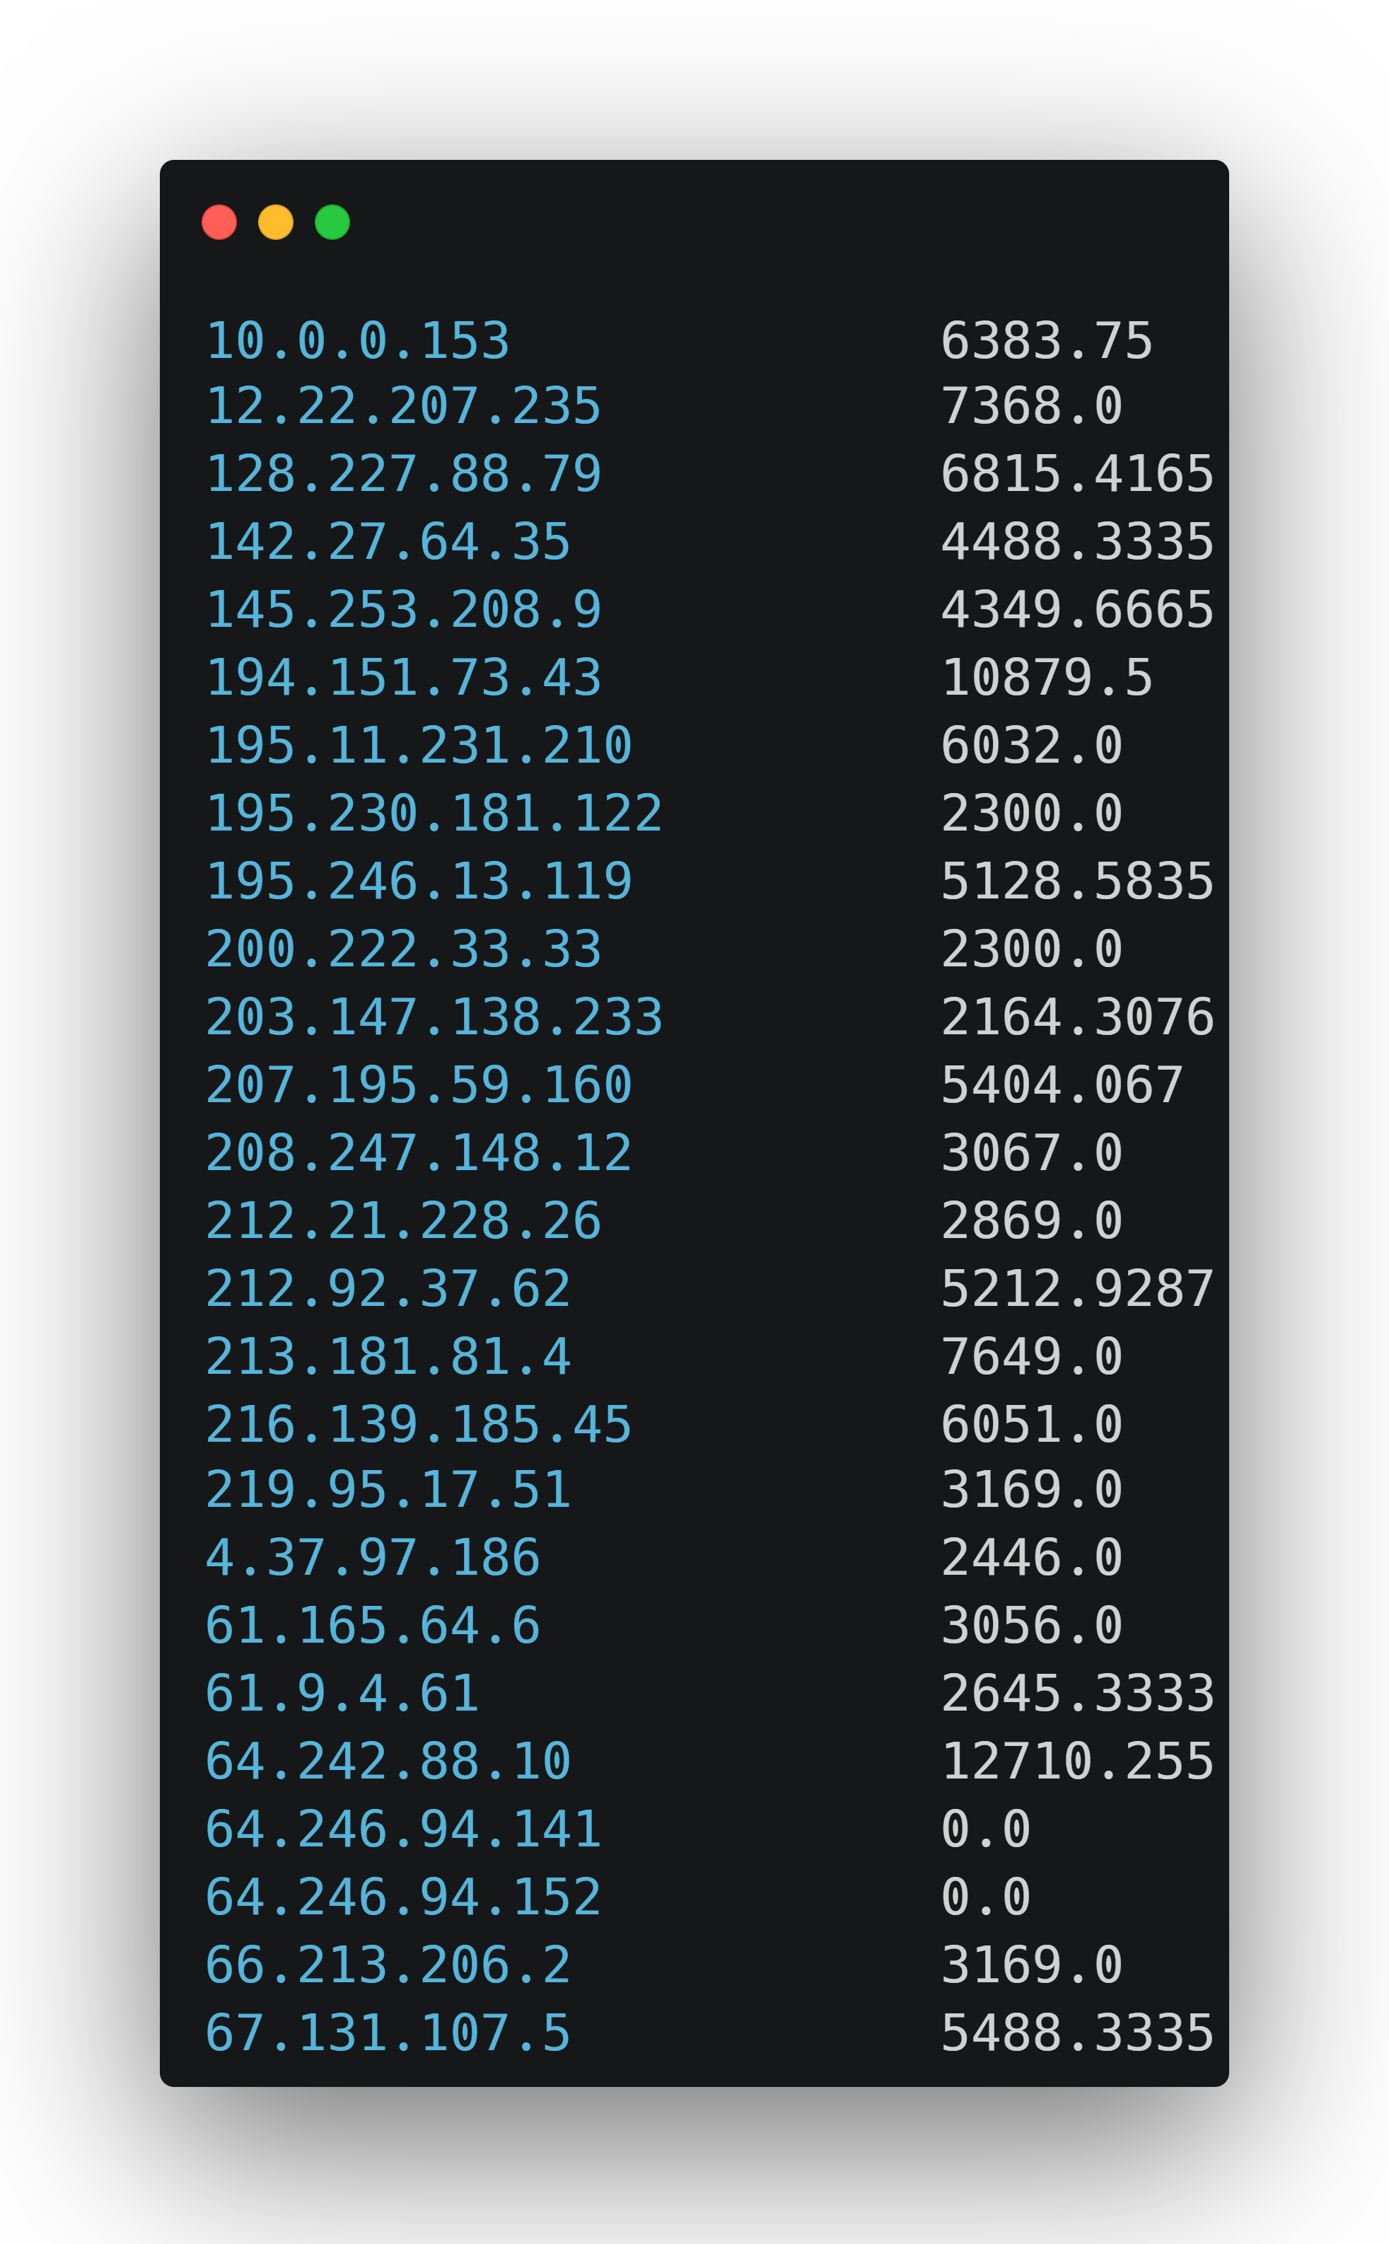
MapReduce Average Result

Slide 7
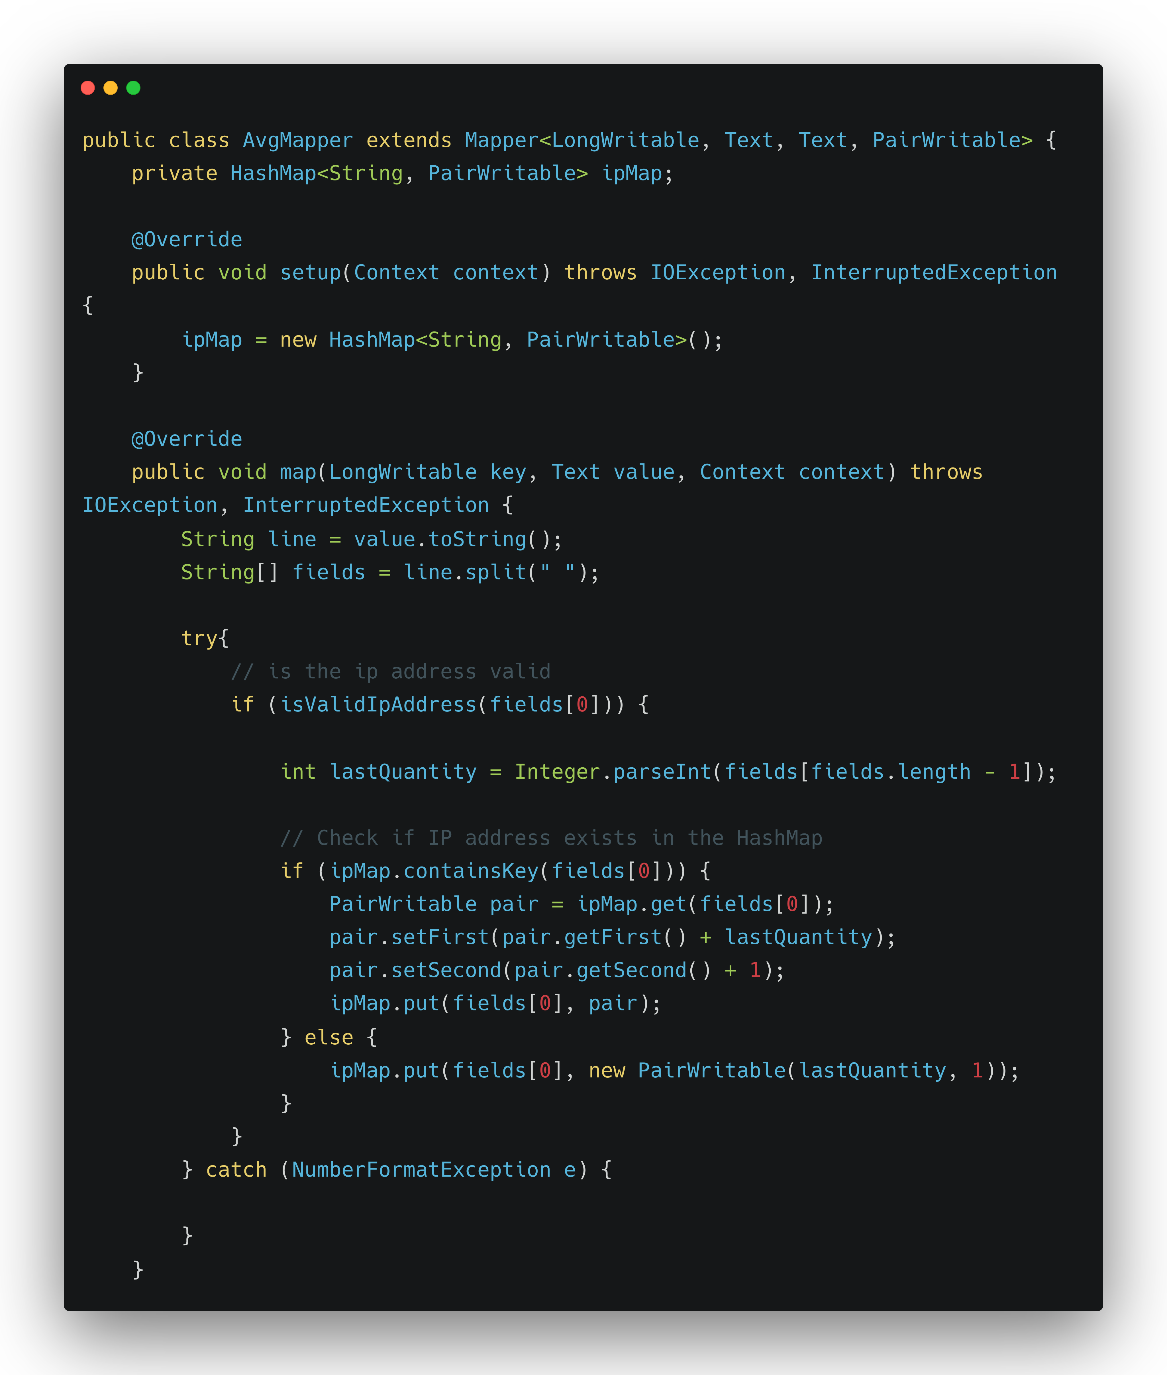
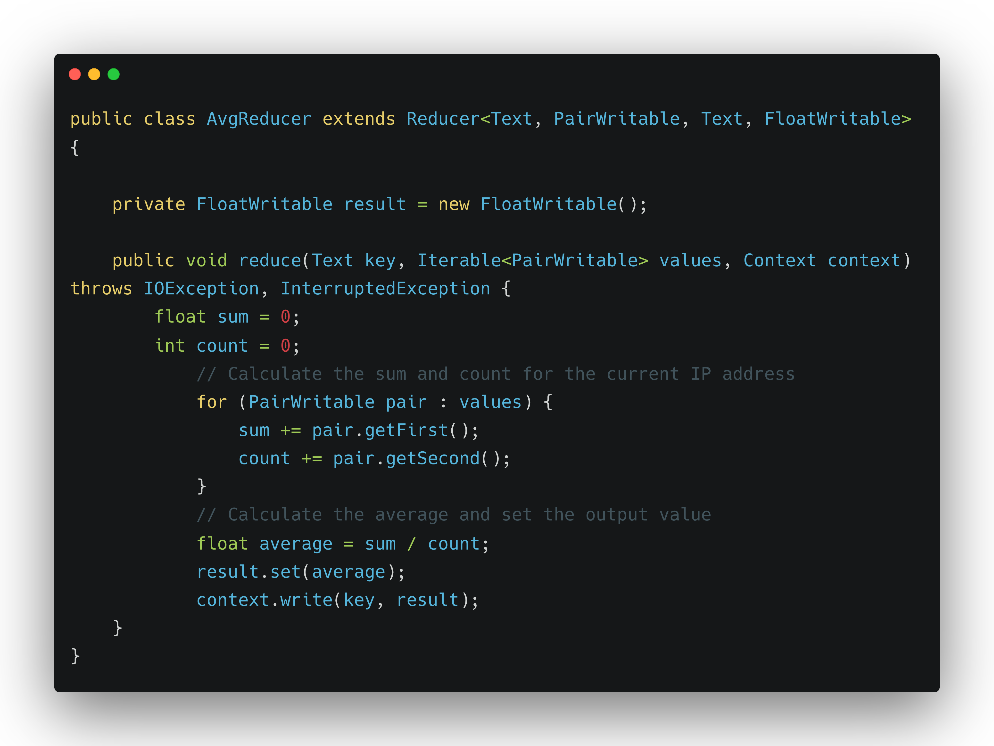
In-Mapper Average

Slide 8
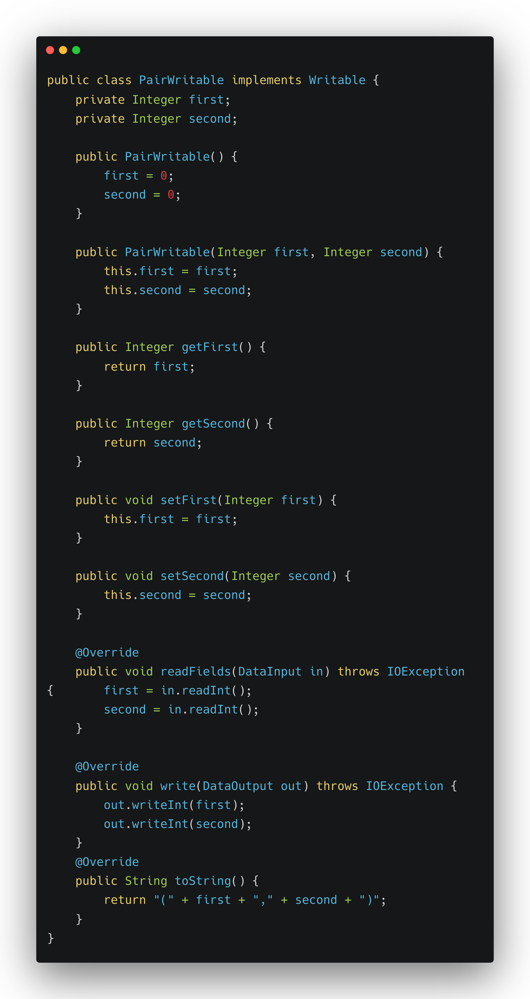
In-Mapper Average (continue)

Slide 9
In-Mapper Average Result

Slide 10
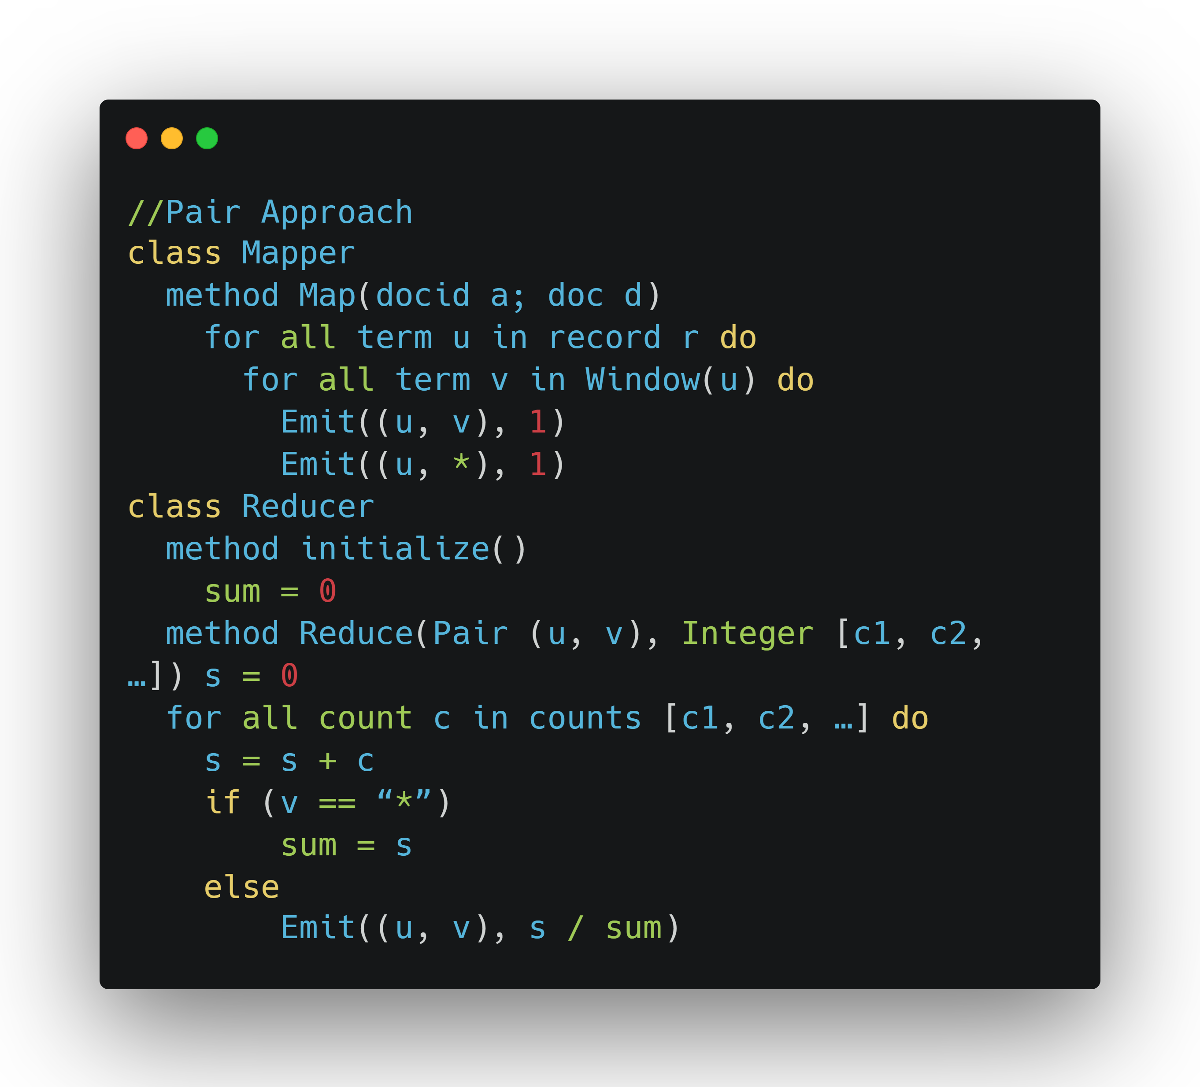
Pair Approach Pseudo Code

Slide 11
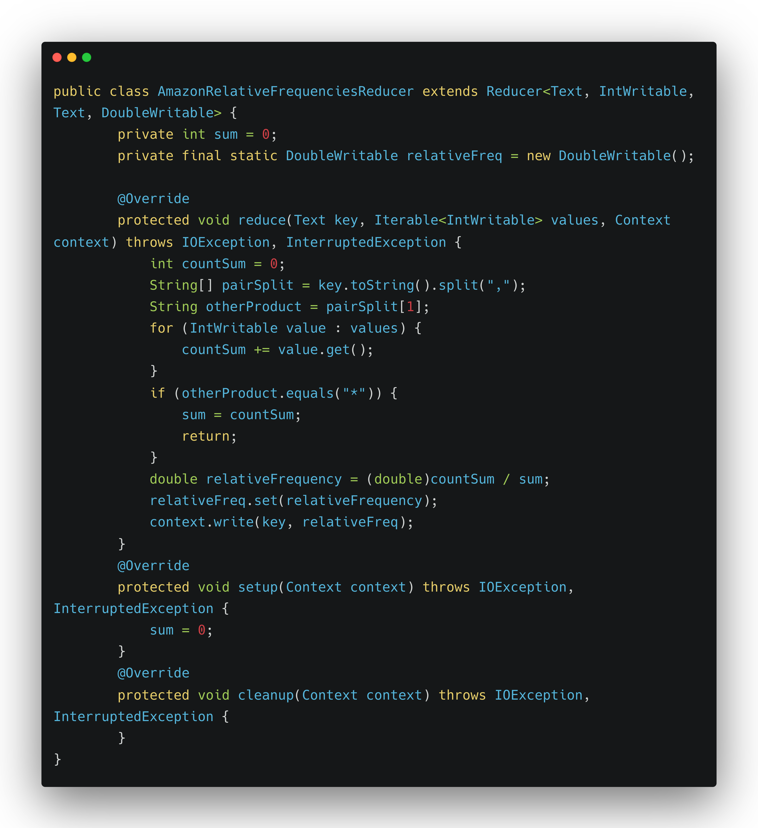
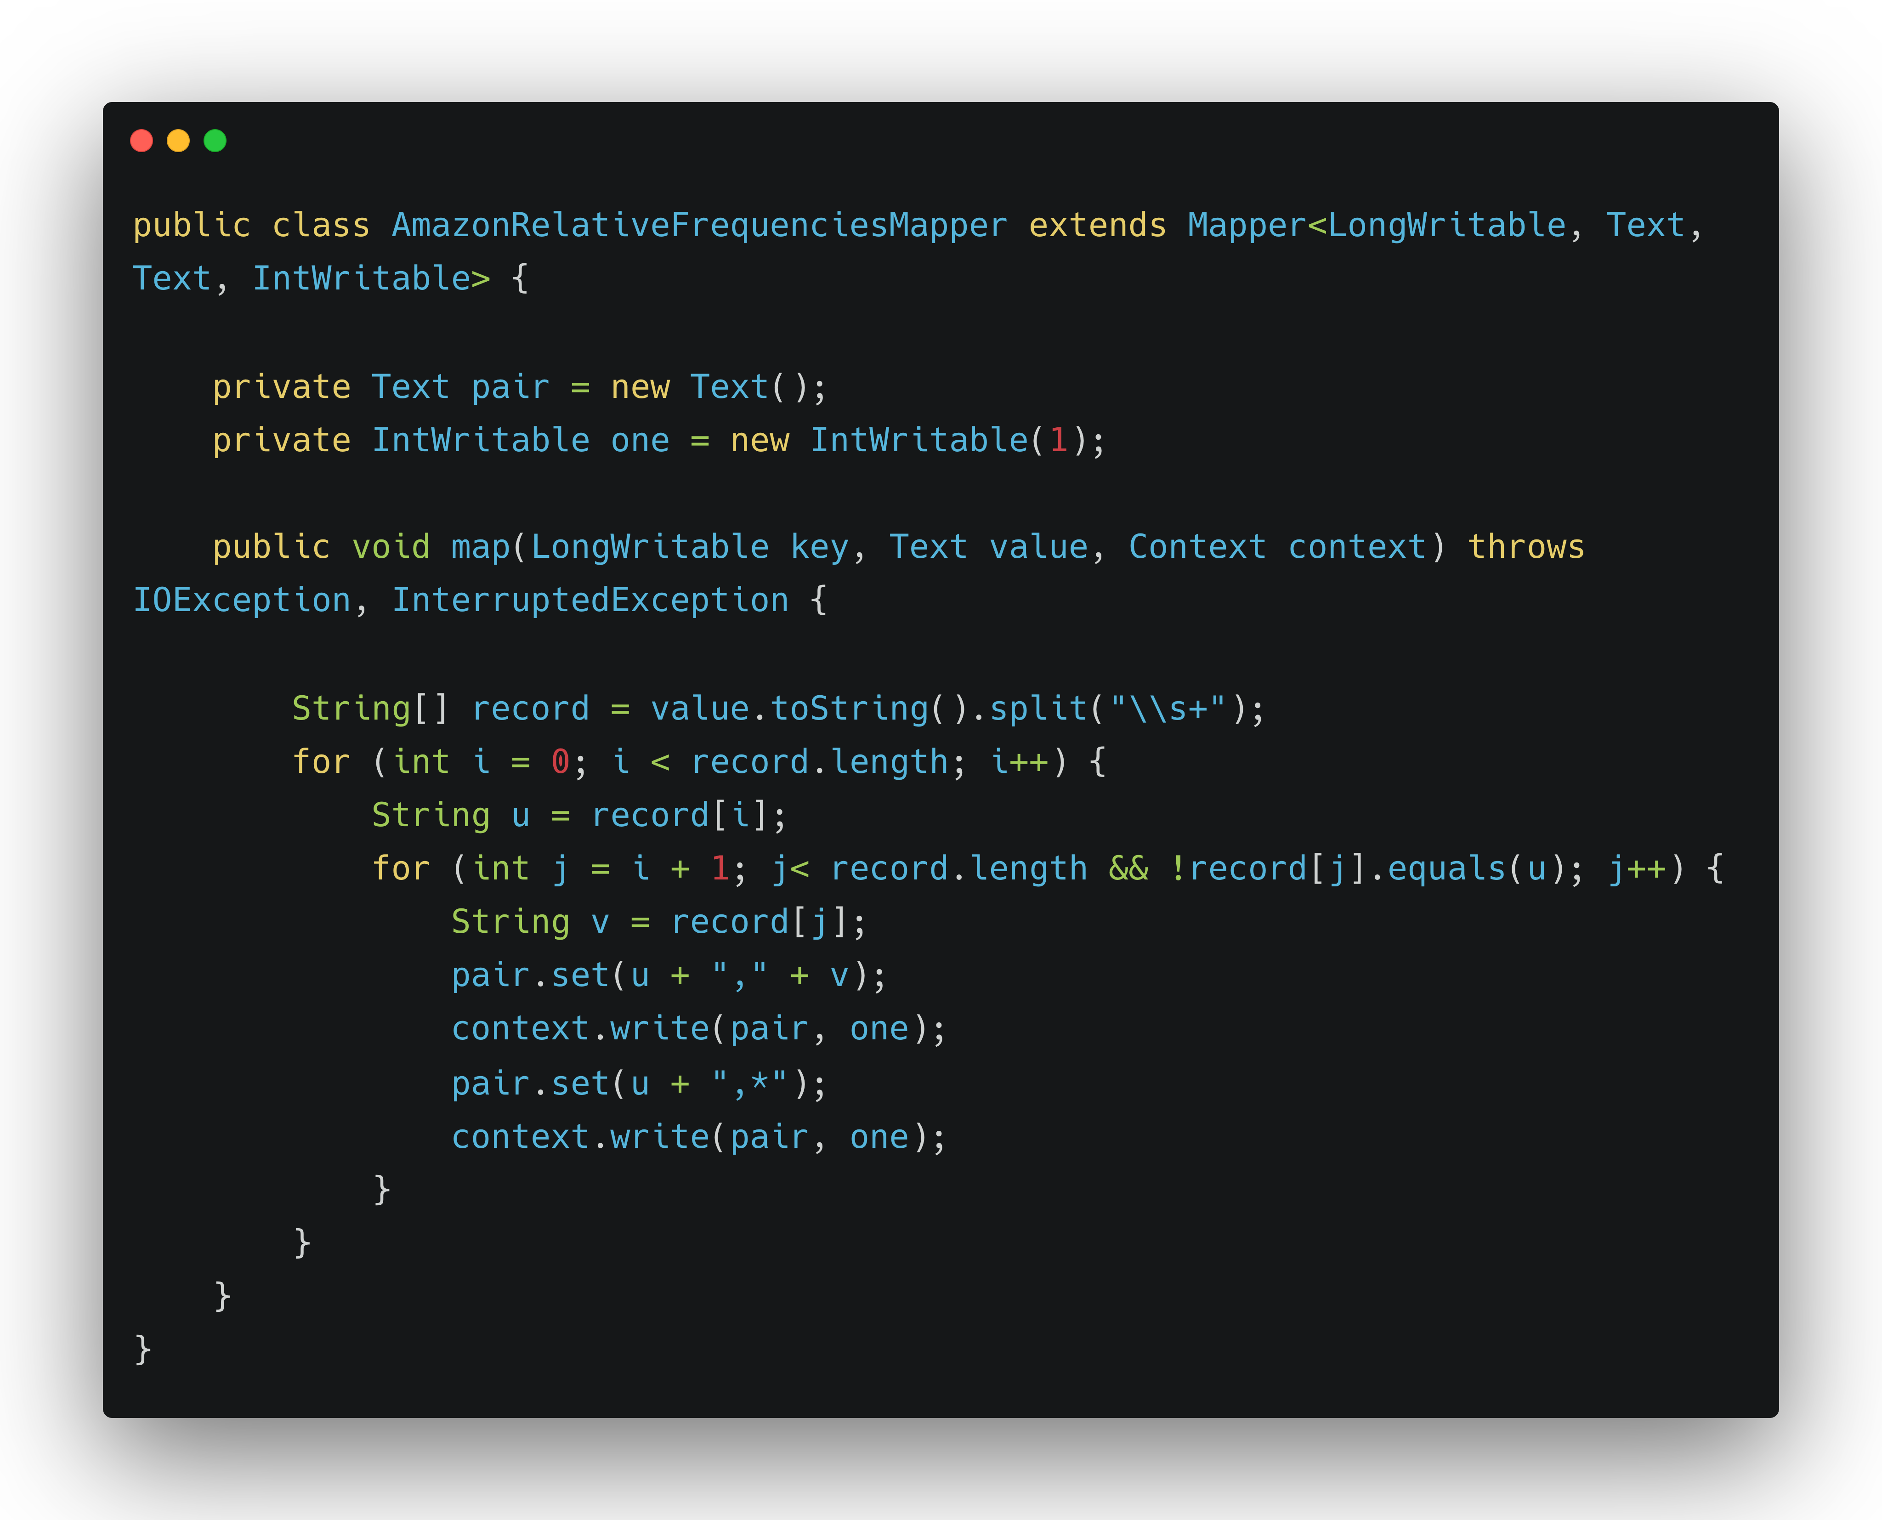
Pair Approach
Java Implementation

Slide 12
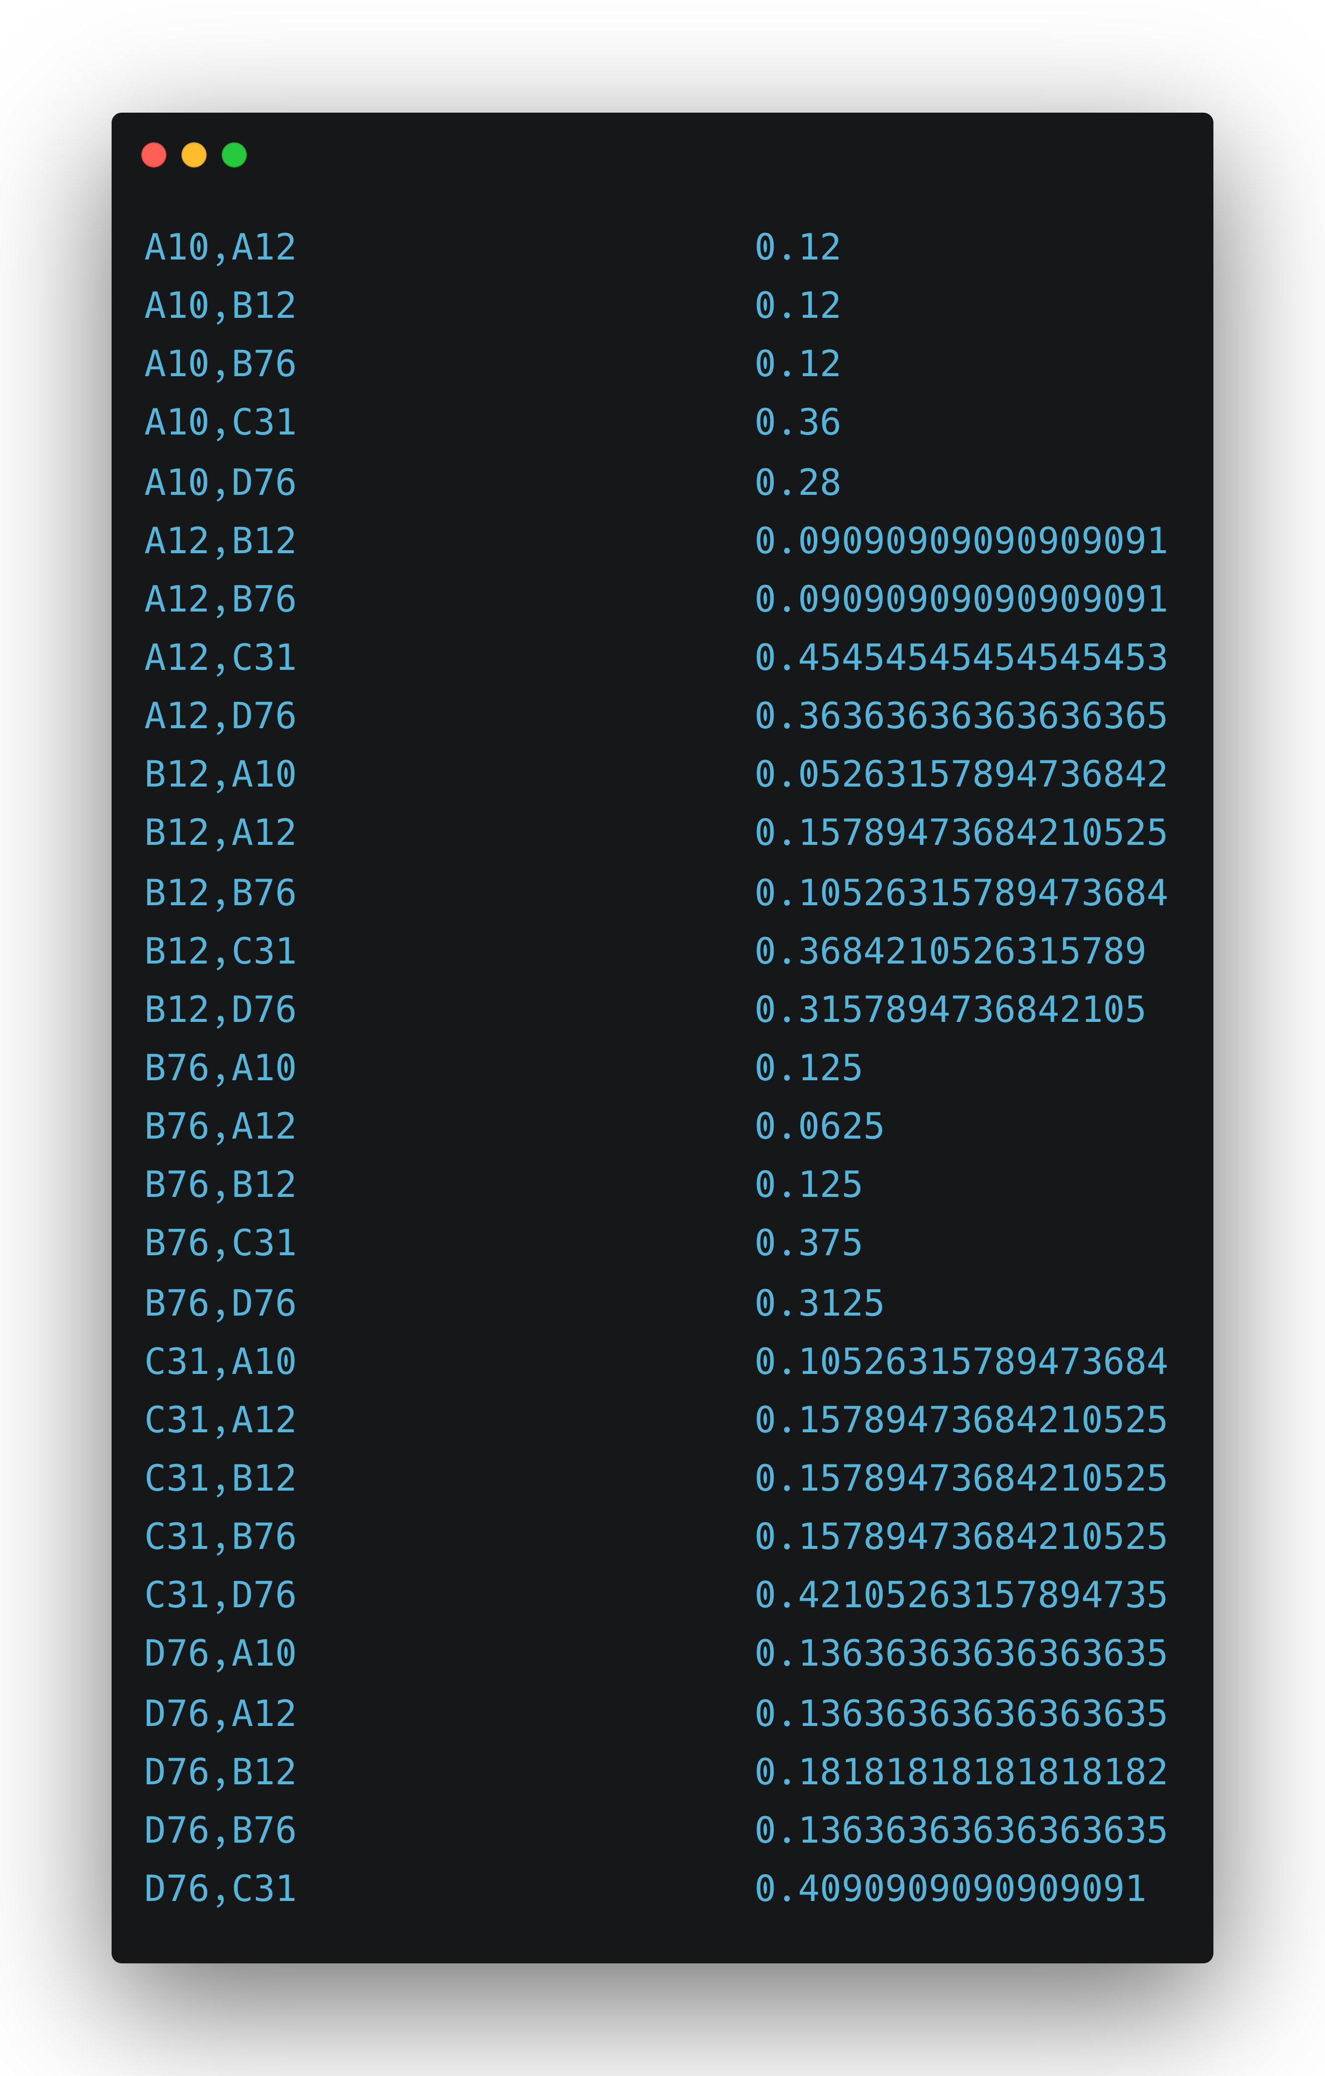
Pair Approach Results

Slide 13
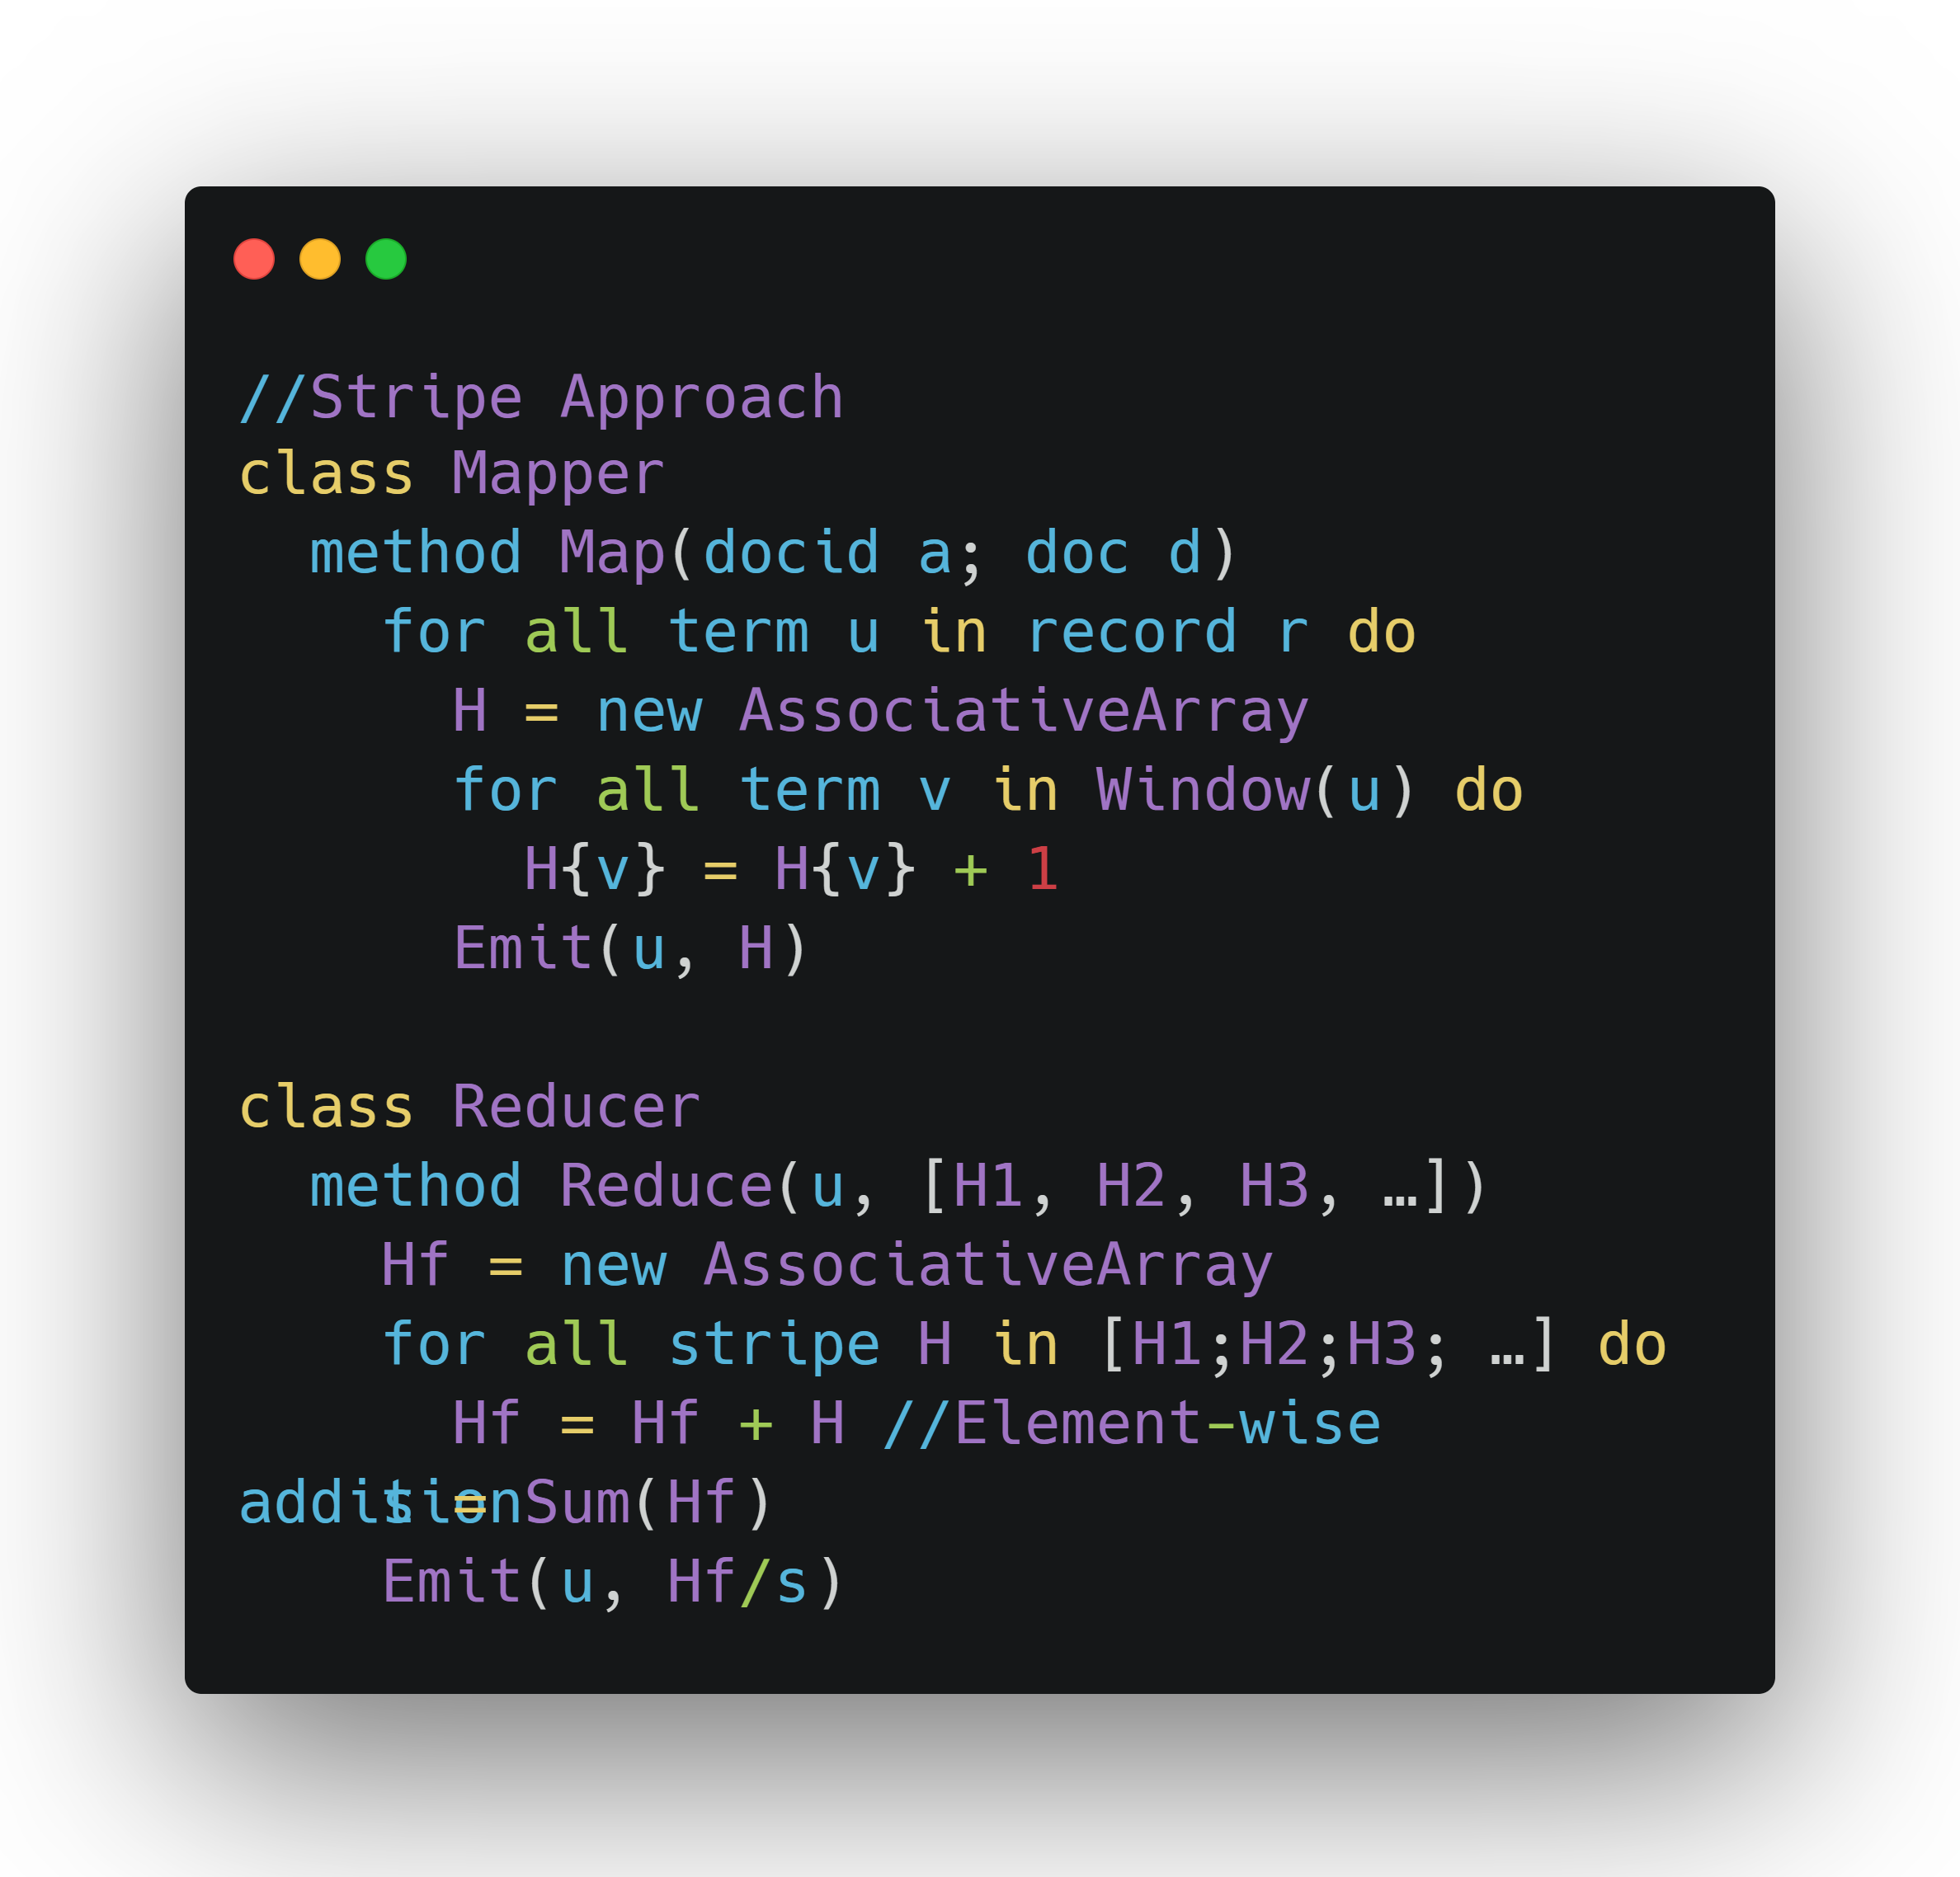
Stripe Approach Pseudo Code

Slide 14
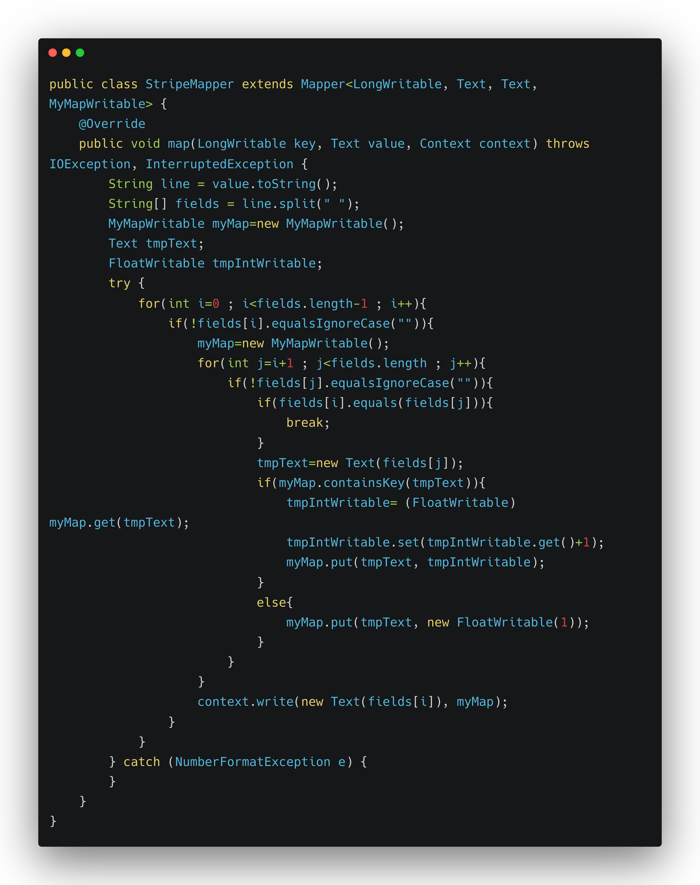
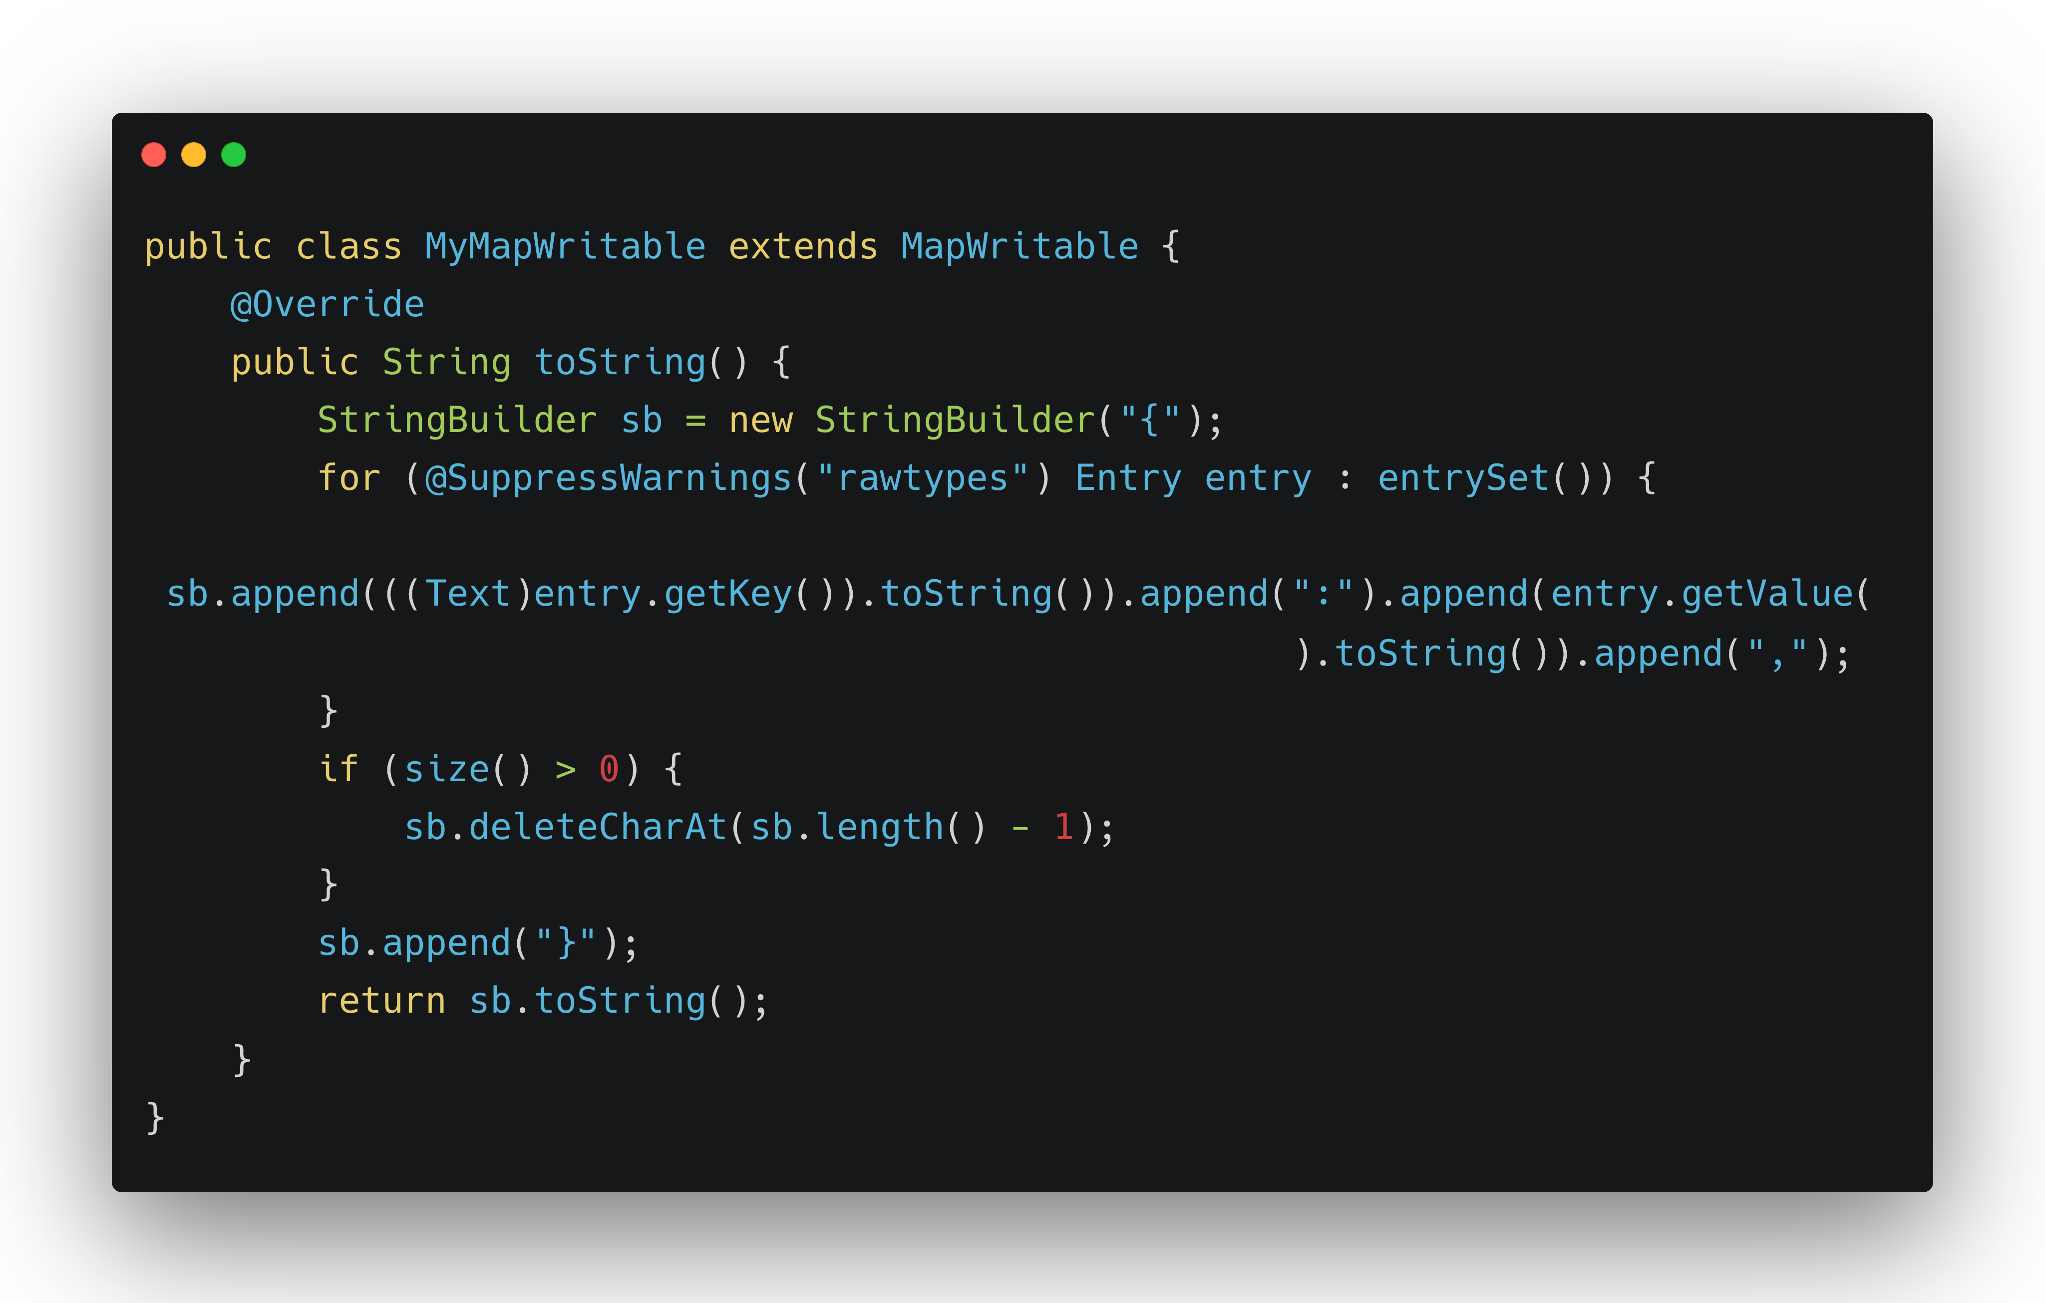
Stripe Approach
Java Implementation

Slide 15
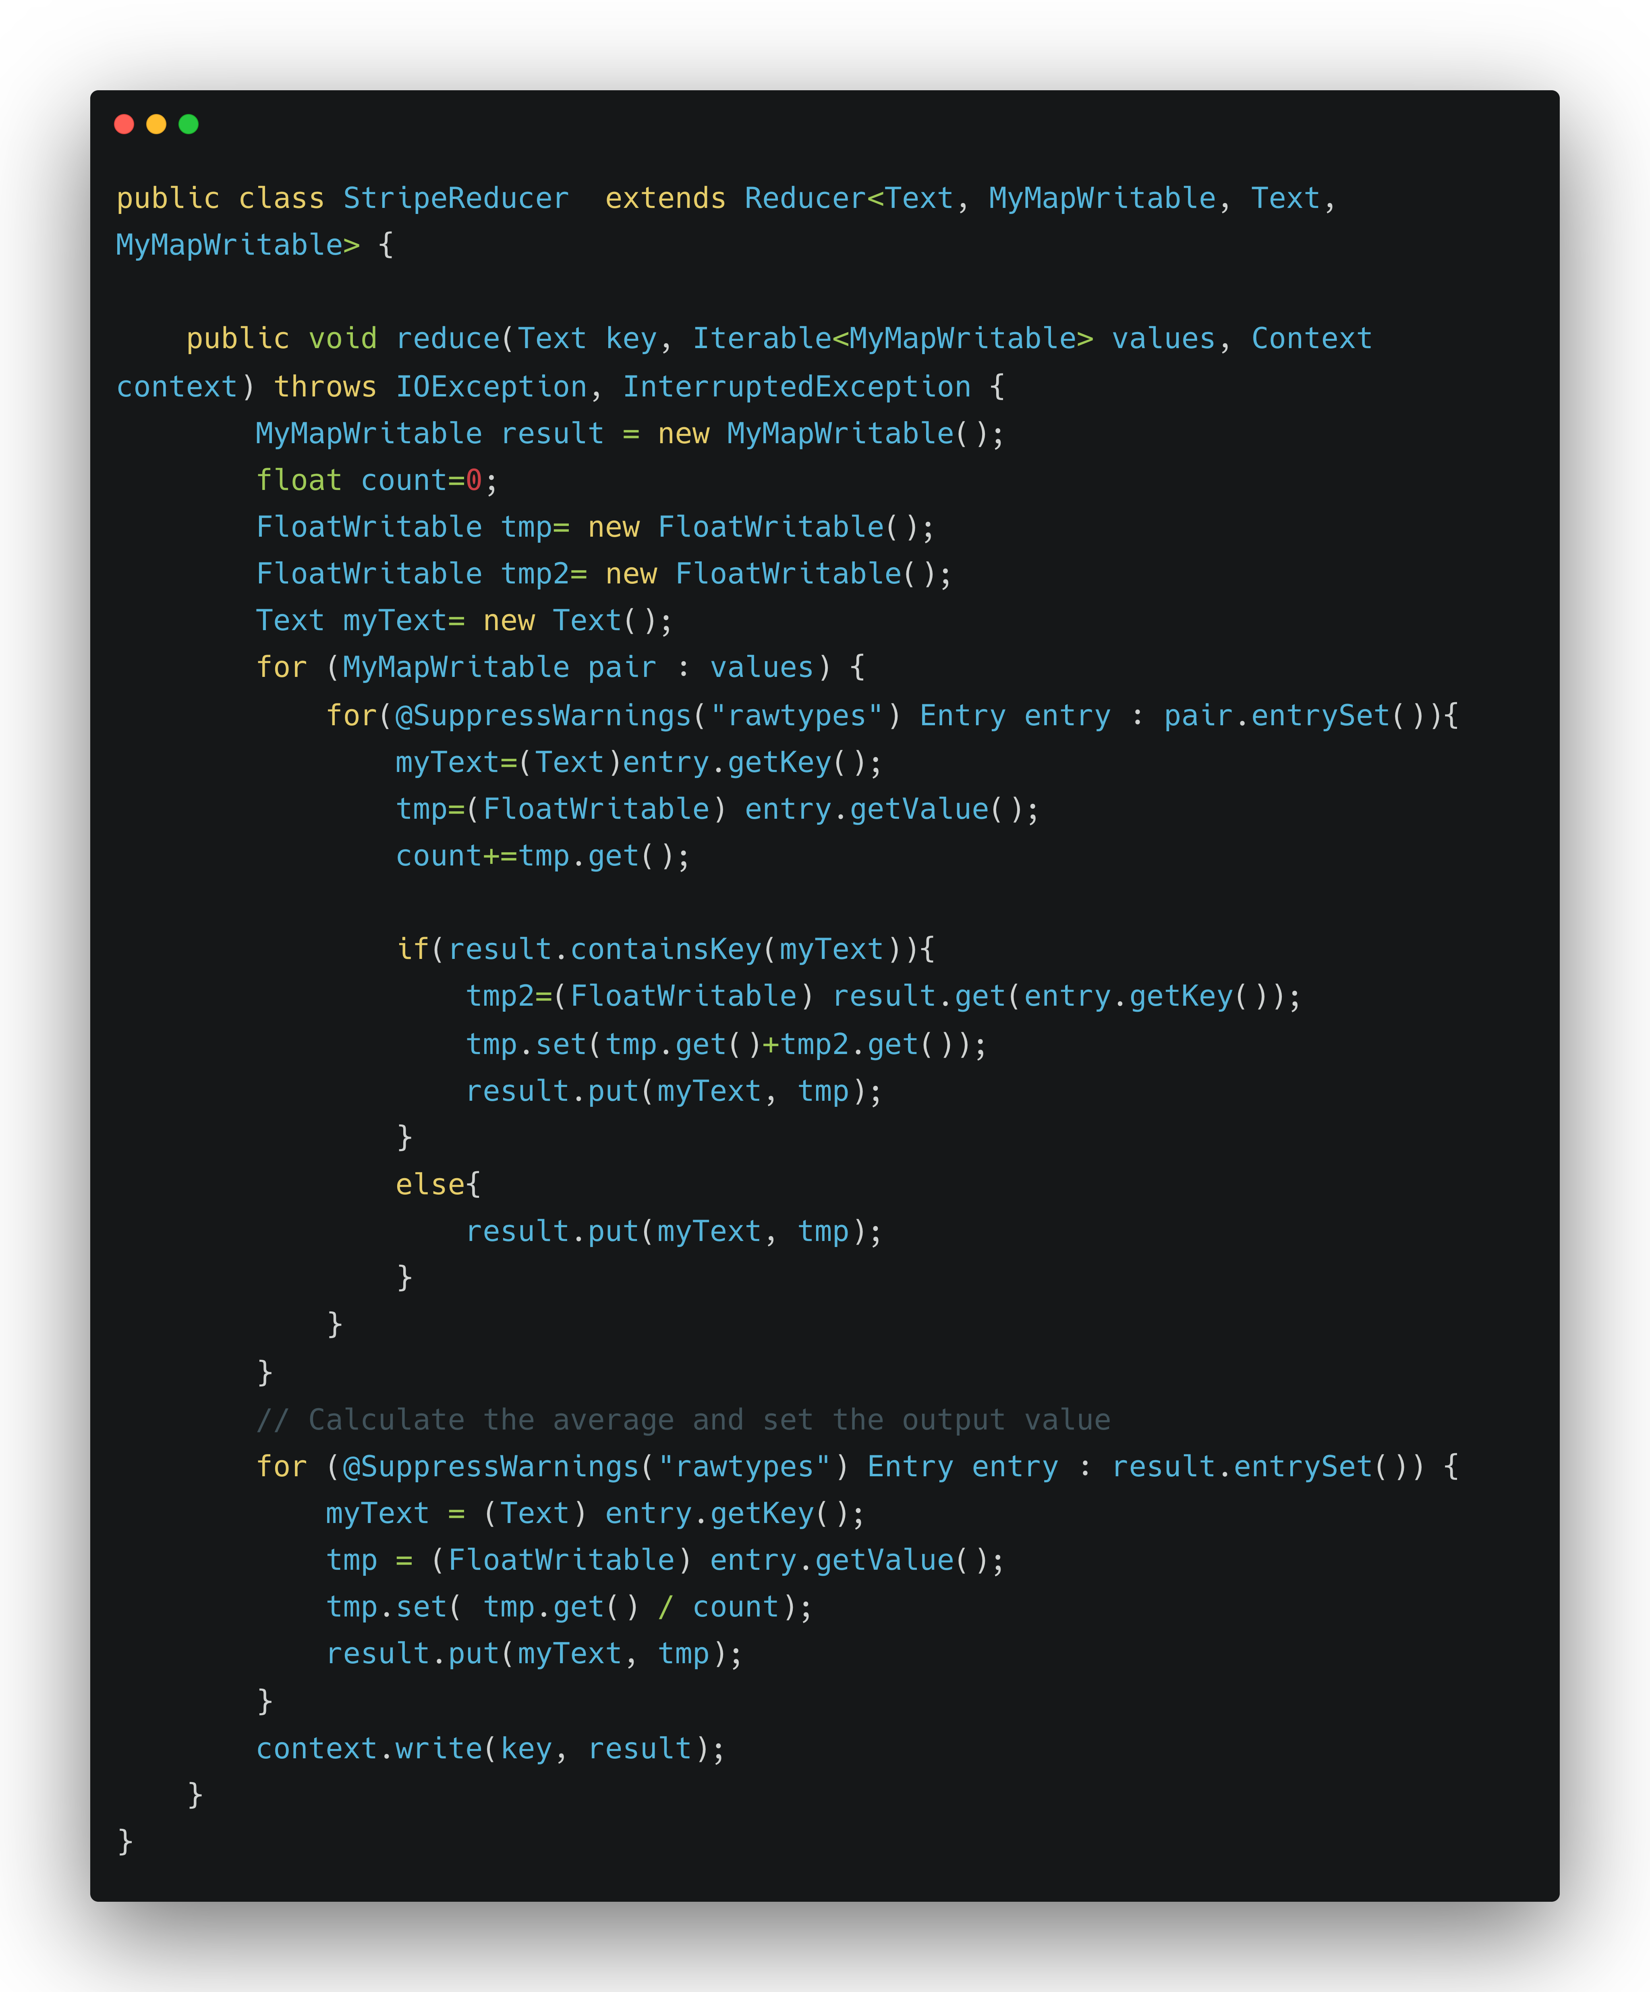
Stripe Approach
Java Implementation
(continue)

Slide 16
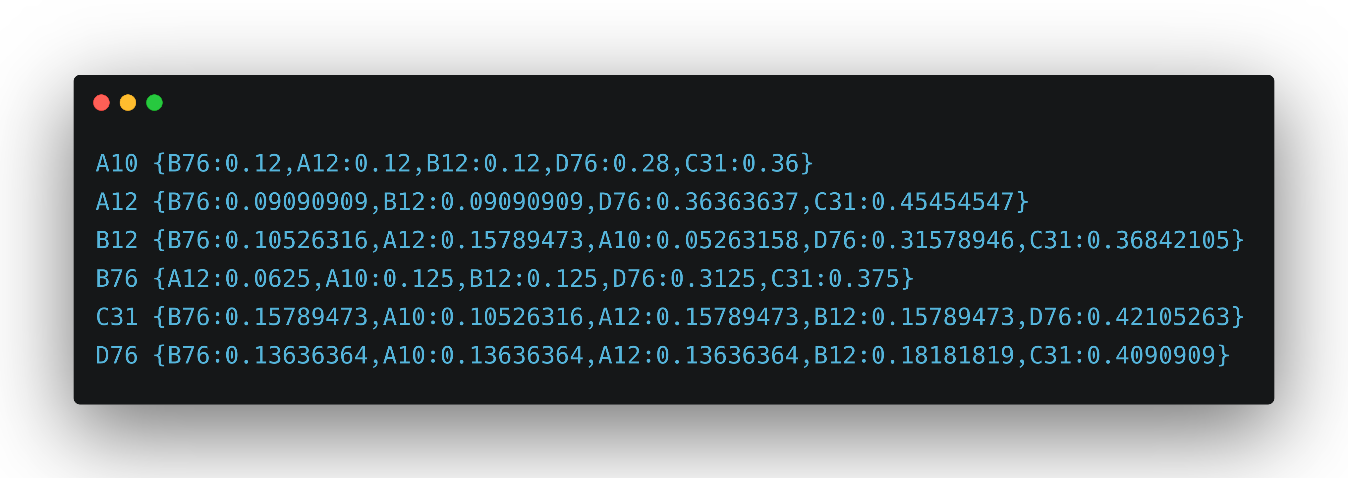
Stripe Approach Results

Slide 17
Pair/Stripe performance Study
3950ms
471MB
3720ms
440MB

Slide 18
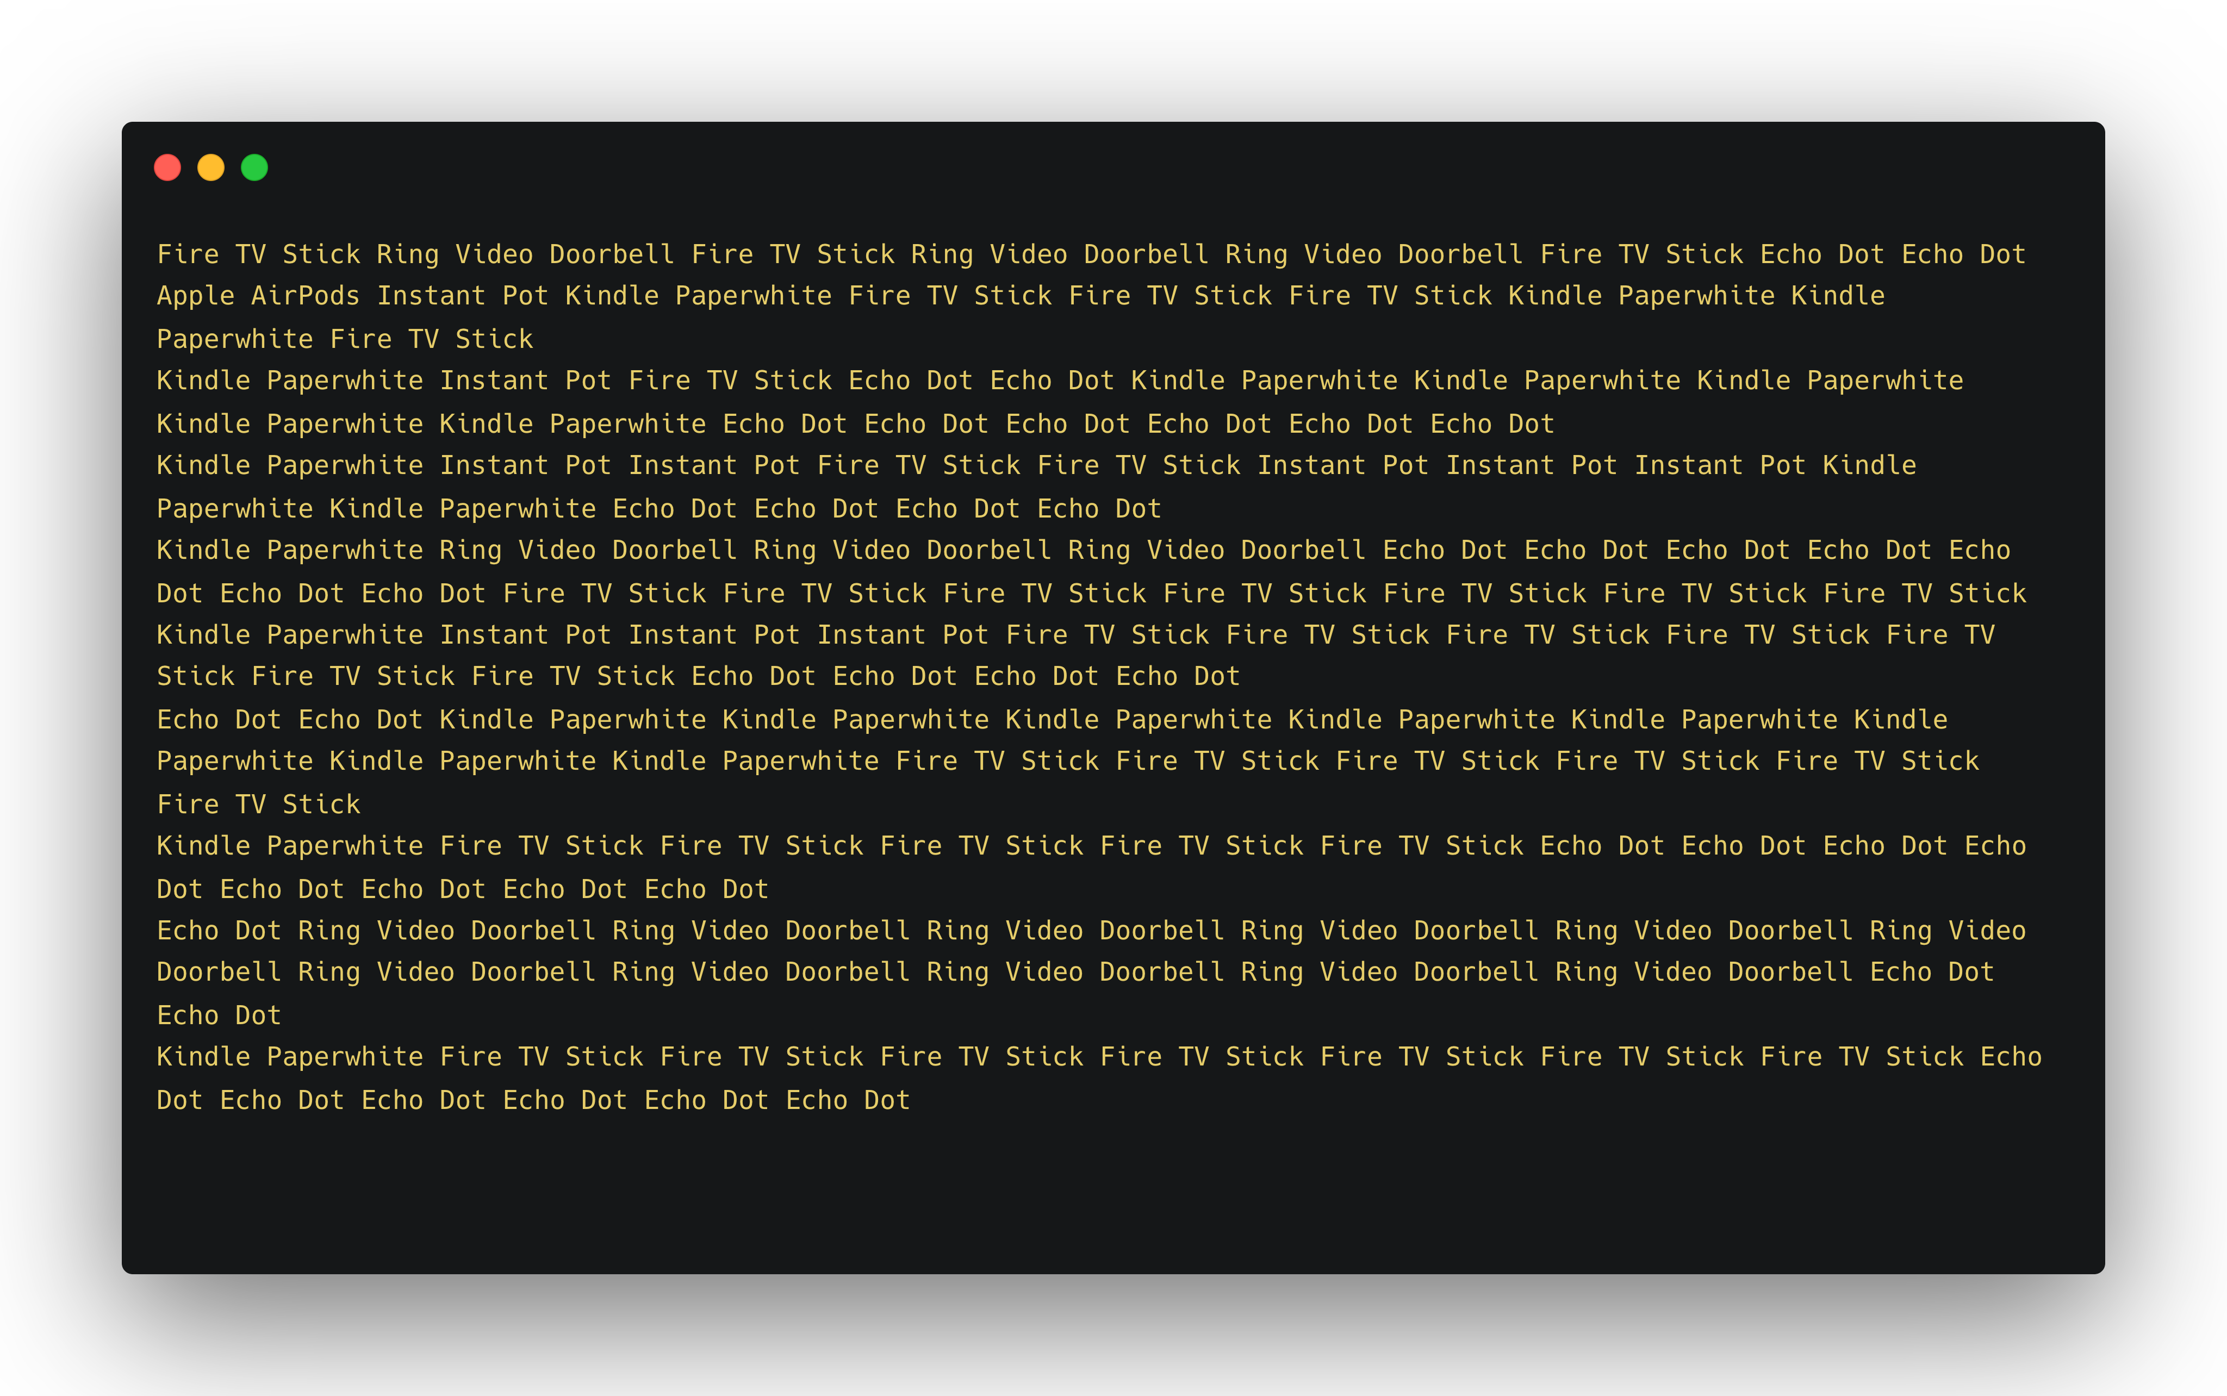
Stripe & Pair Performance
on Group Data
Group Data:

Slide 19
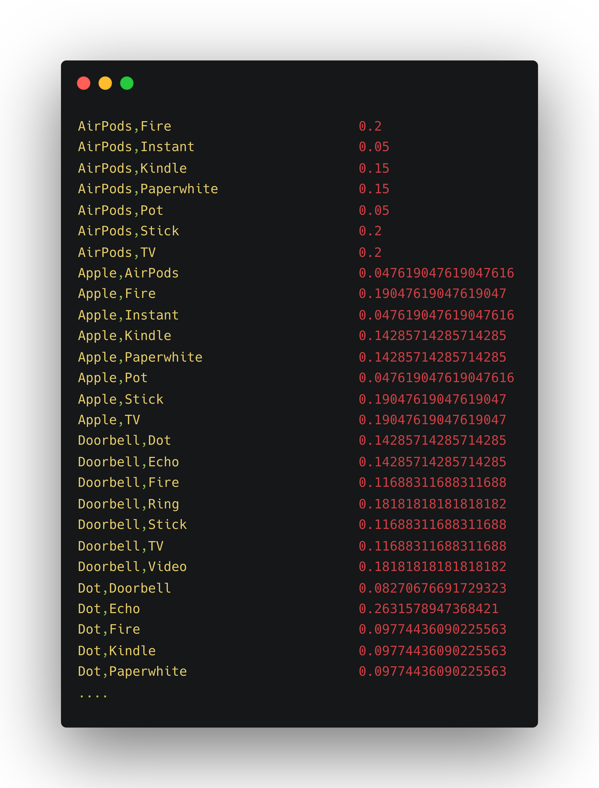
Pair Approach Results
on Group Data

Slide 20
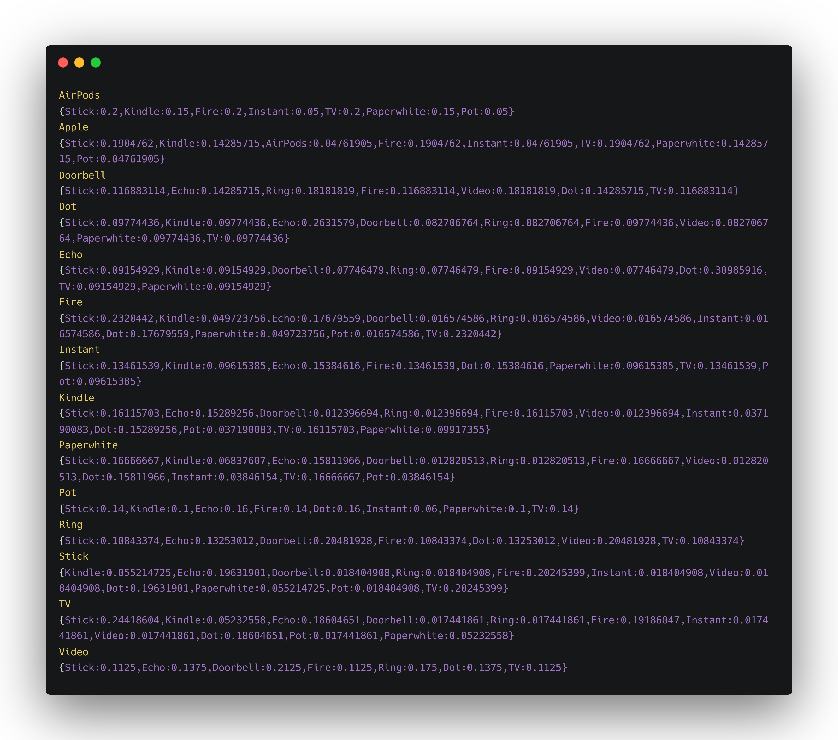
Stripe Approach Results
on Group Data

Slide 21
Pair/Stripe performance Study on Group Data
4900ms
439MB
4440ms
433MB

Slide 22

Exploring Statistical Techniques for Big Data Analysis with spark & scala

Slide 23
INTRODUCTION
Handling big data computation with the power of spark and scala
Exploring Statistical Techniques for Big Data Analysis on real world scenario (bootstrapping)

Slide 24
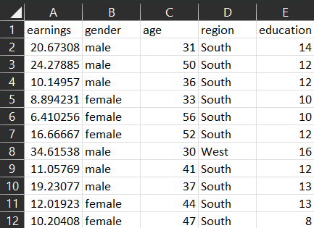

Stock and Watson current population survey ANalysis
Label »
Earnings : numerical
Feature »
Gender : [female][male]
Age : numerical [22-64]
region: [Midwest][South][West][Northeast]
Education: numerical [6-18]
Data Set: 61395 row
No missing values
Link: https://vincentarelbundock.github.io/Rdatasets/csv/AER/CPSSW8.csv

Slide 25
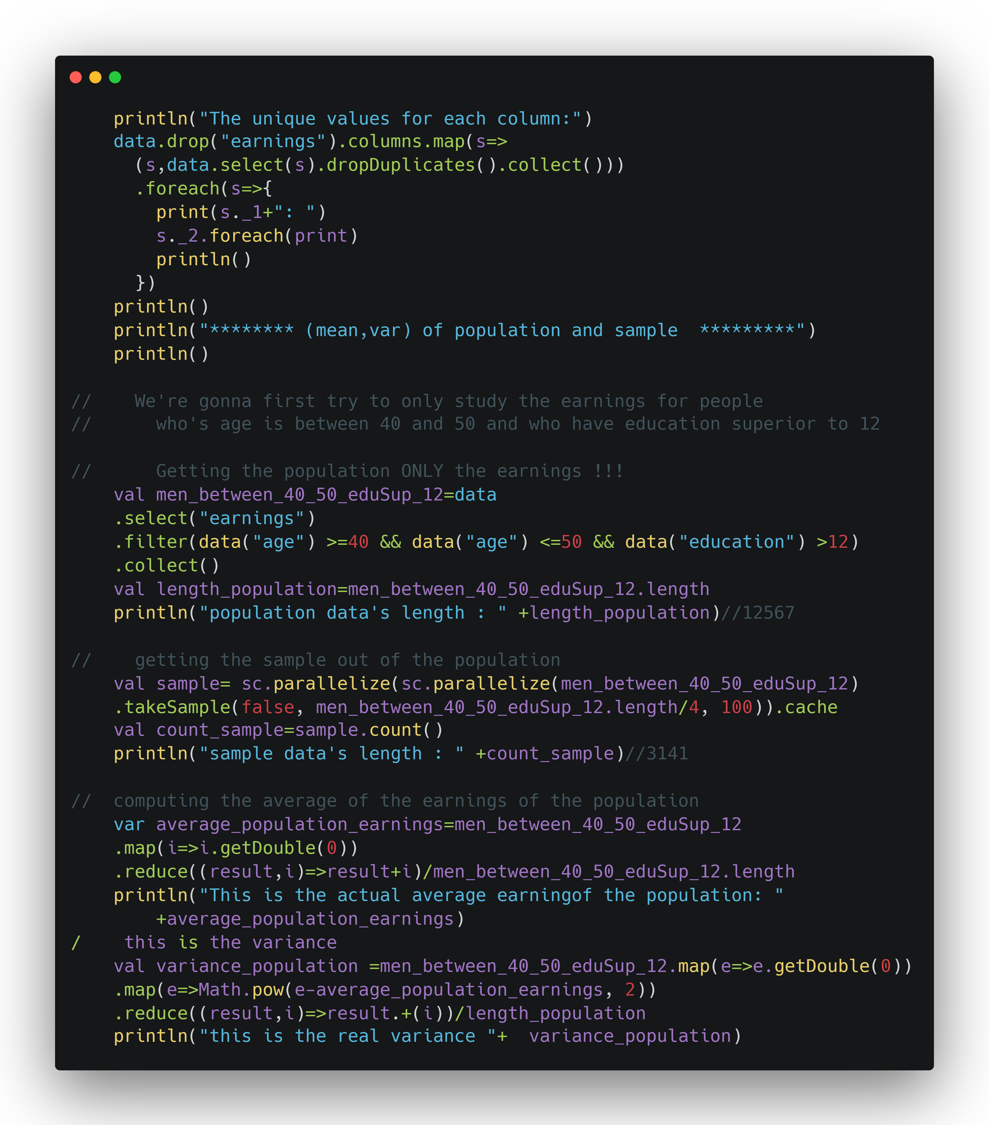
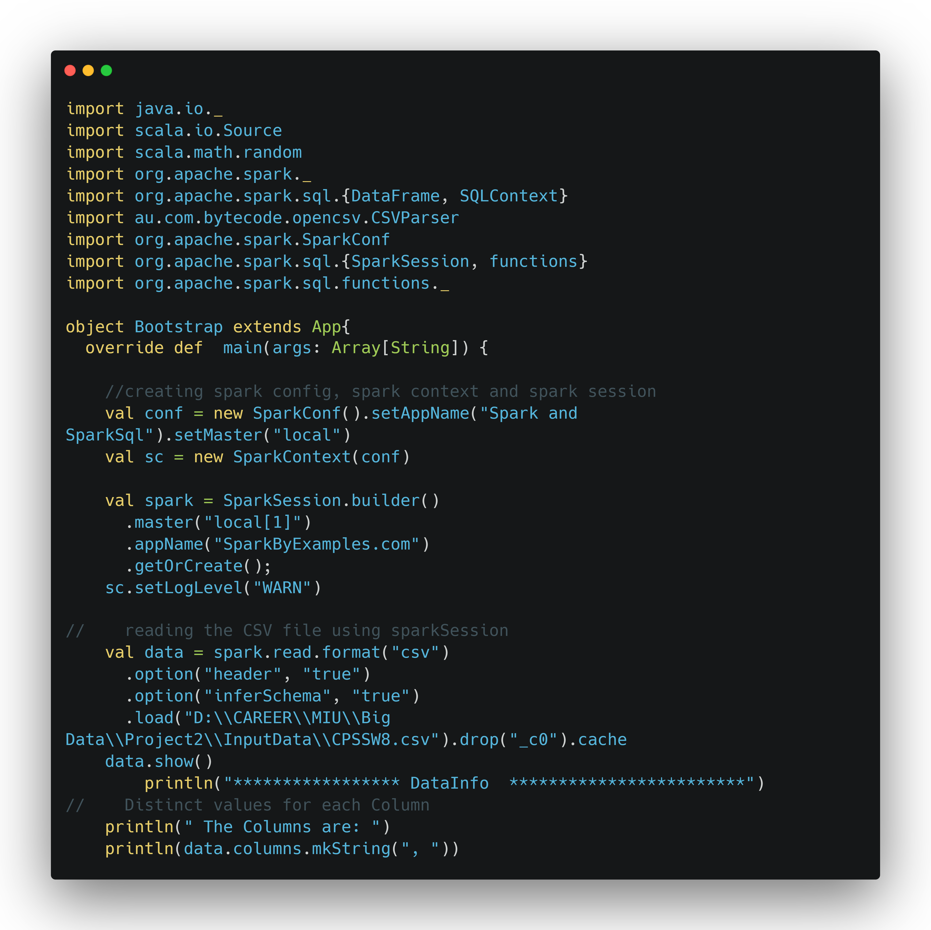
Scala Code

Slide 26
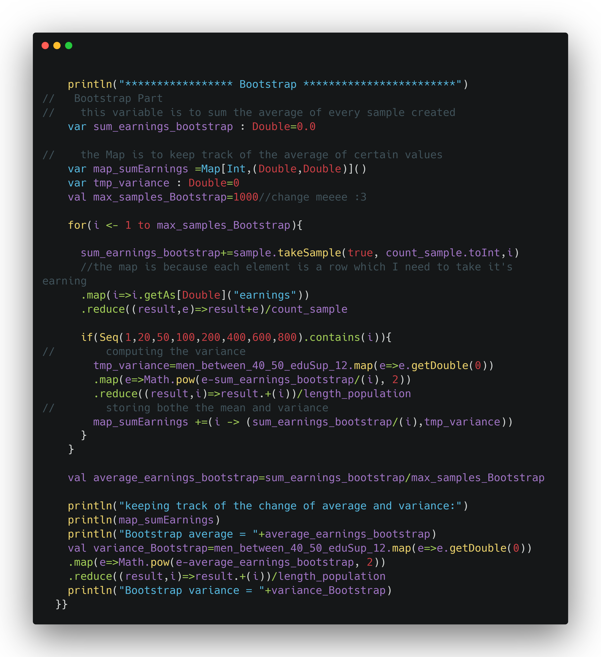
Scala Code

Slide 27
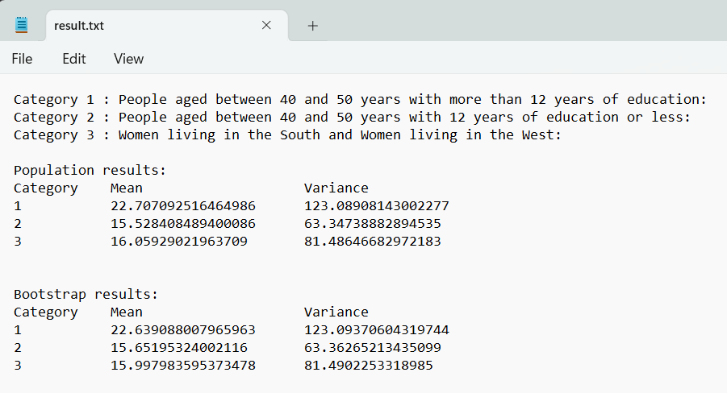
Results

Slide 28
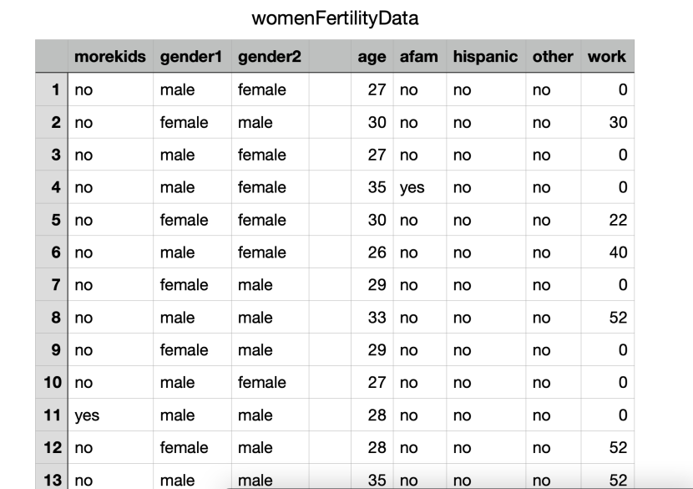
Women fertility analysis
Gategorical variable : « MoreKids» a binary variable
Numeric variable : « age»
Data Set: 2.291.894 row
No missing values
Link: https://vincentarelbundock.github.io/Rdatasets/csv/AER/Fertility.csv

Slide 29
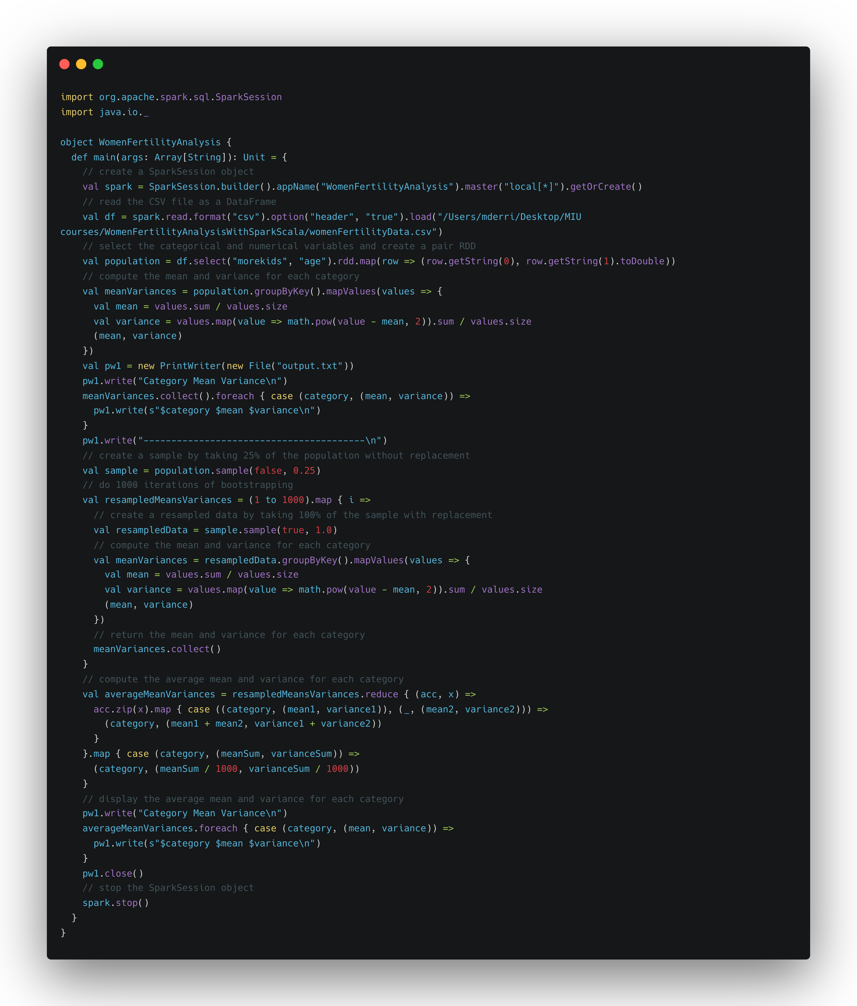
Scala Code

Slide 30
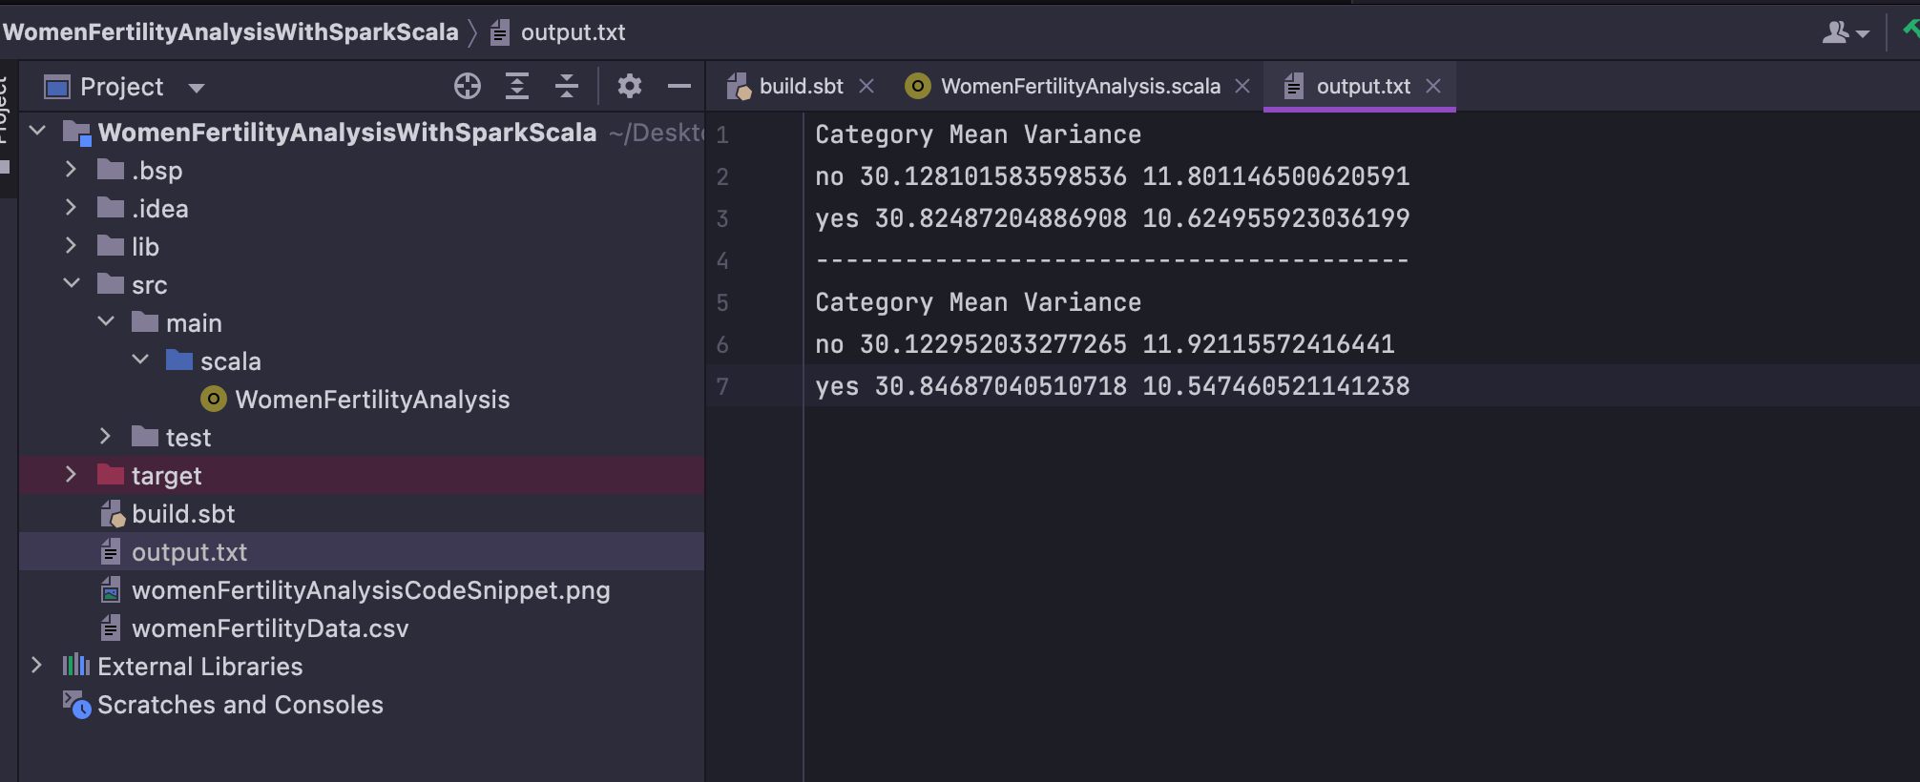
Result

Slide 31
SUMMARY

Slide 32
THANK YOU

Slide 33
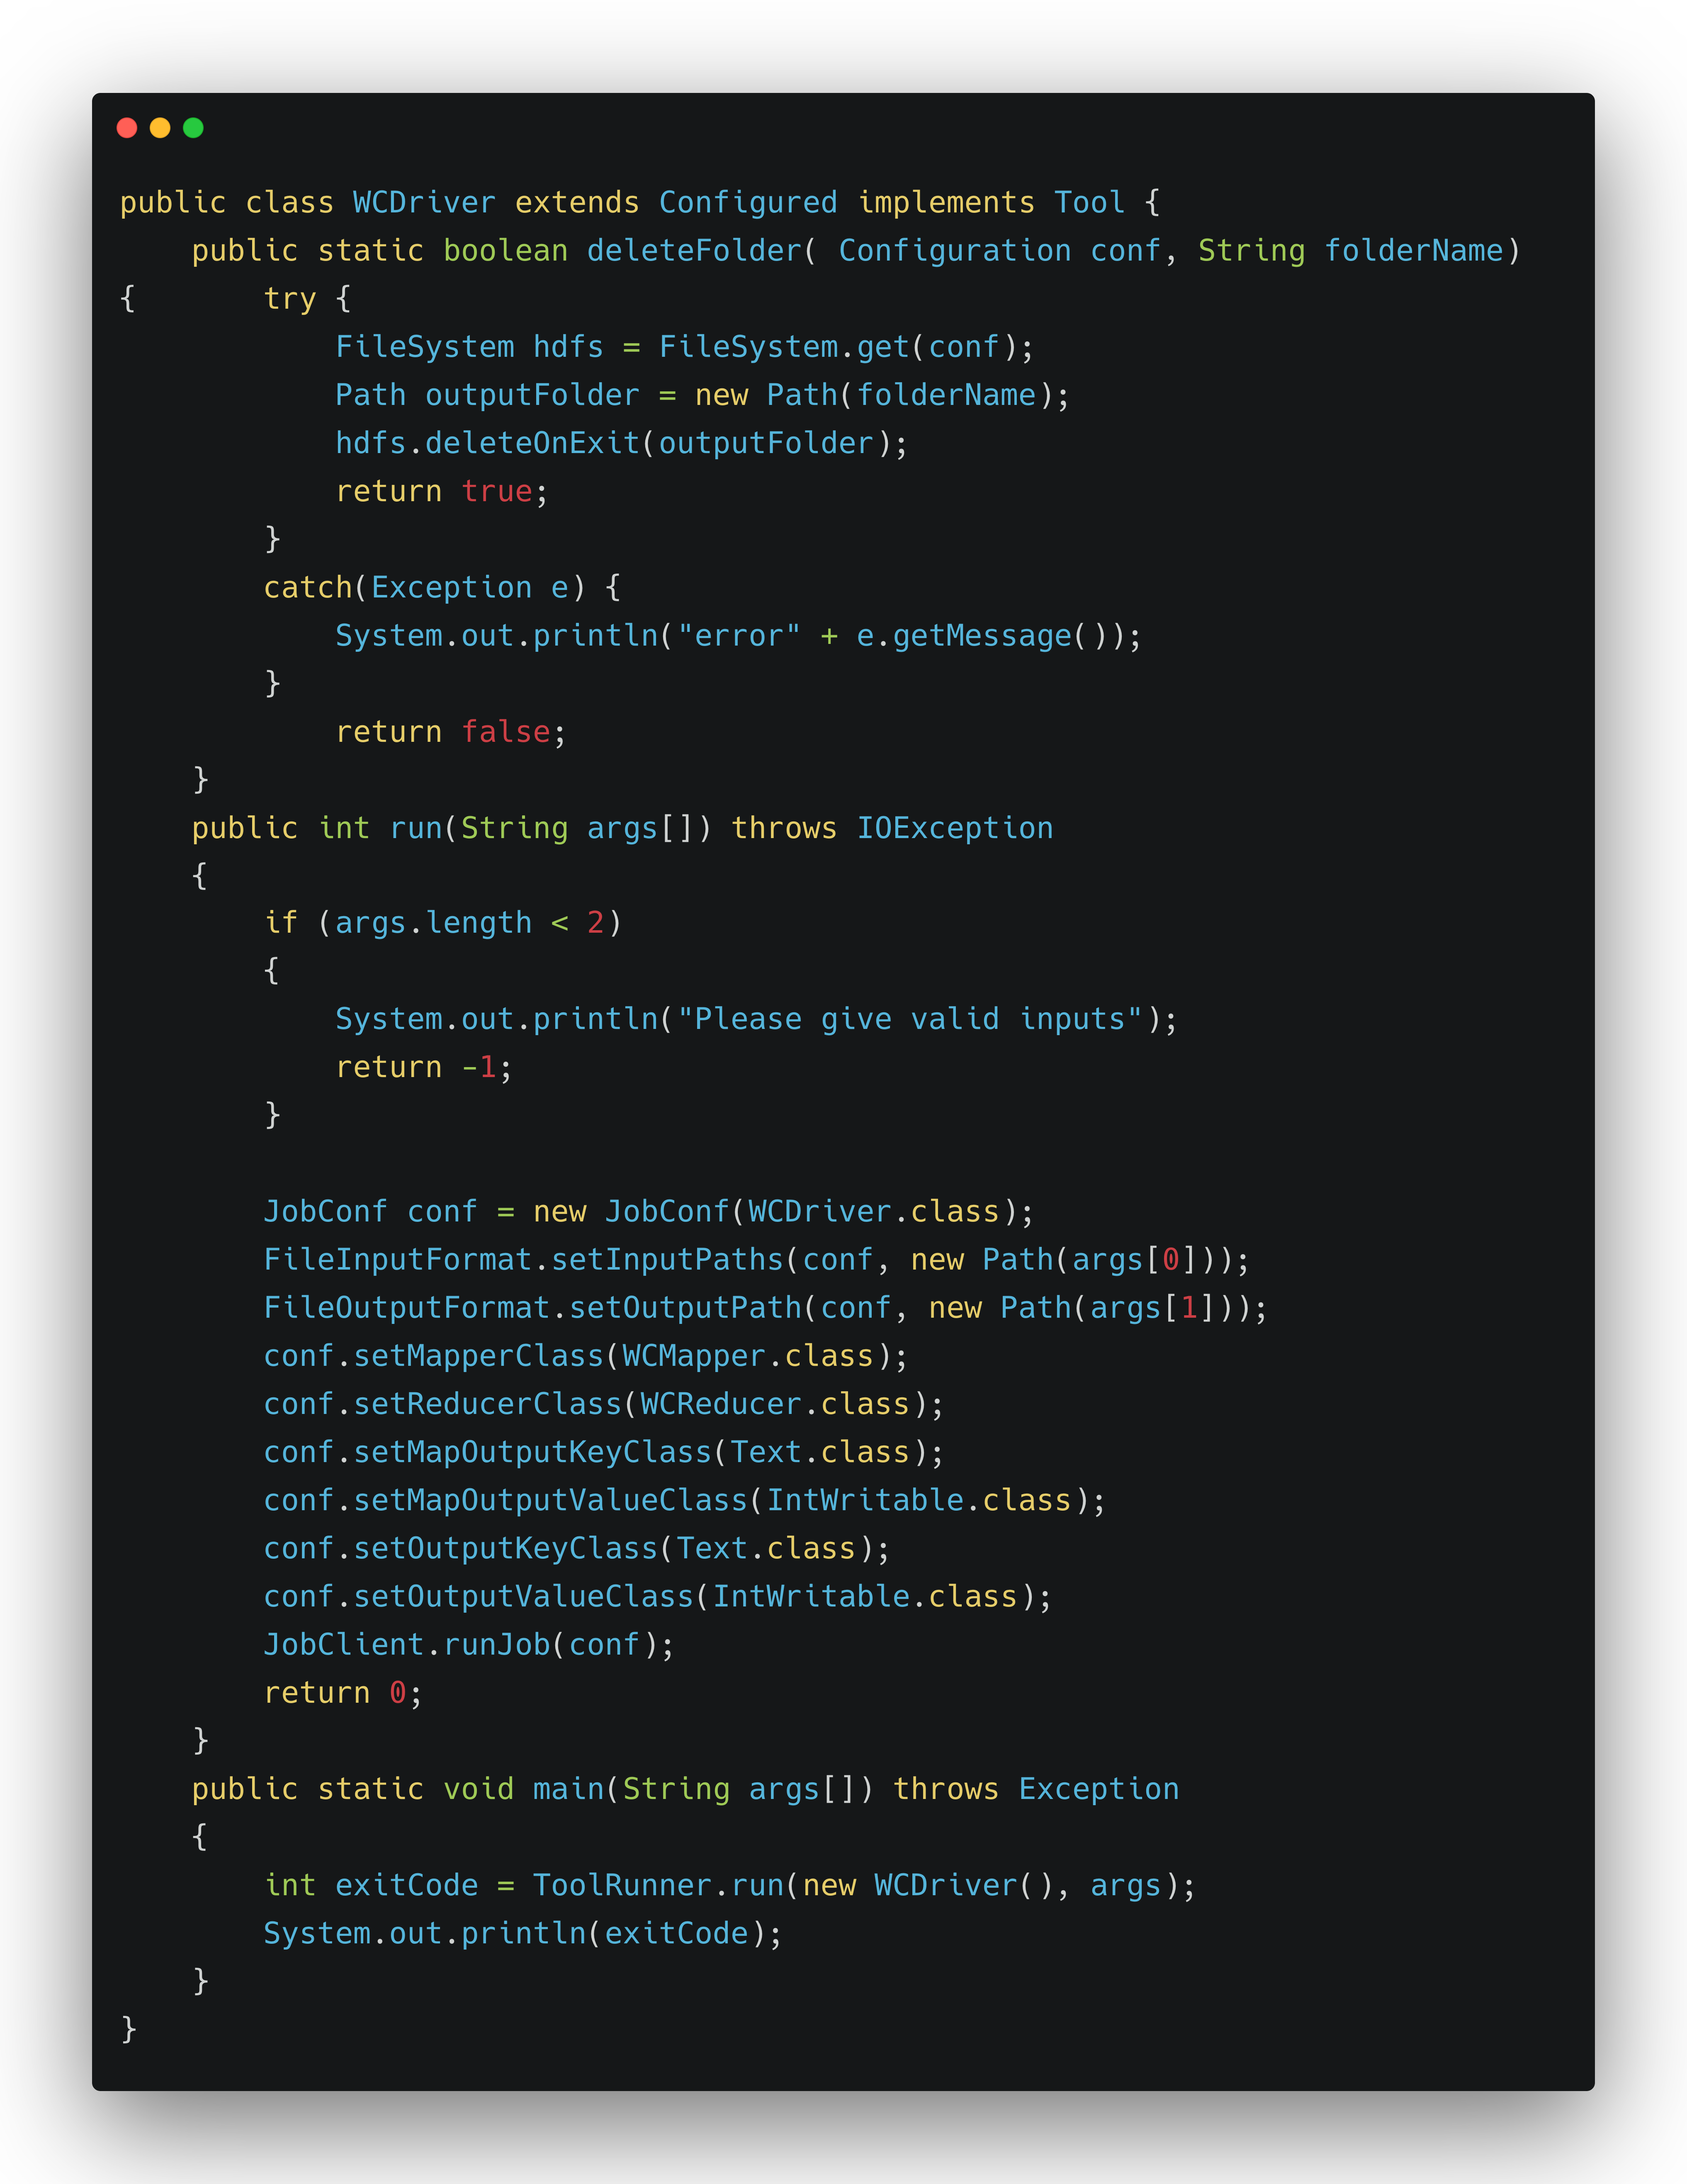
In-Mapper
Word Count Driver

Slide 34
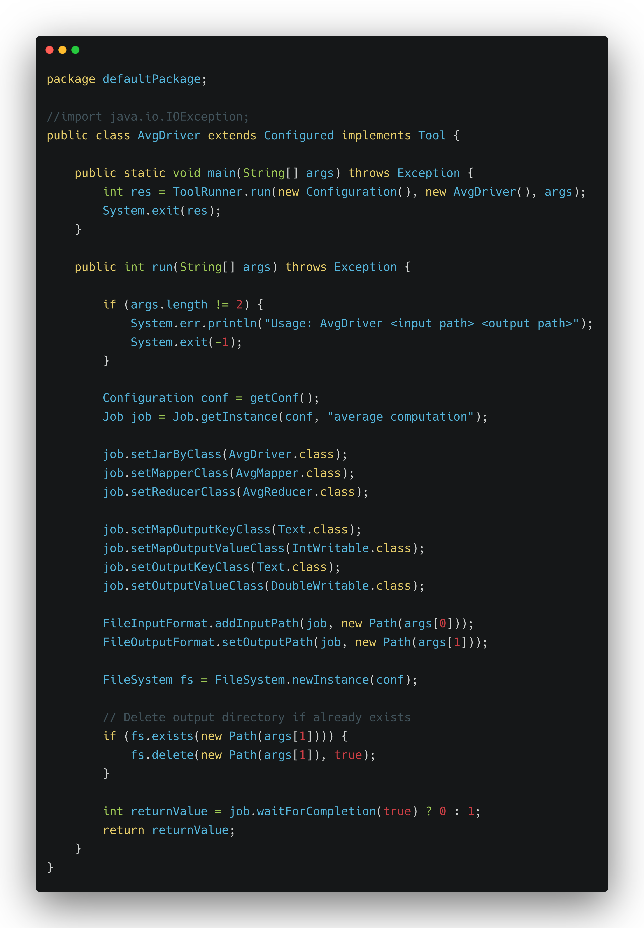
MapReduce Average Driver

Slide 35
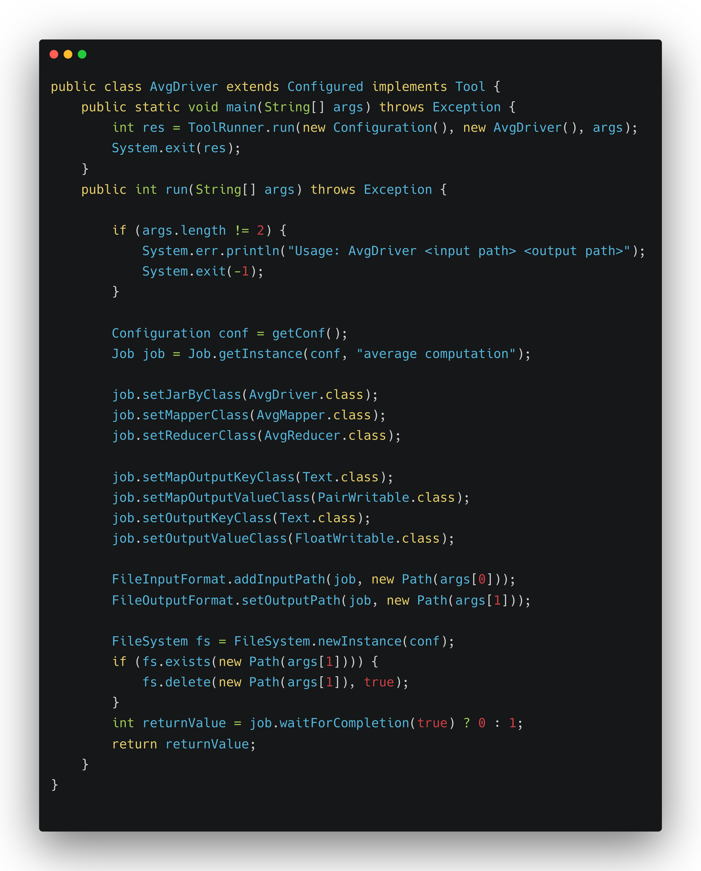
In-Mapper
Average Driver

Slide 36
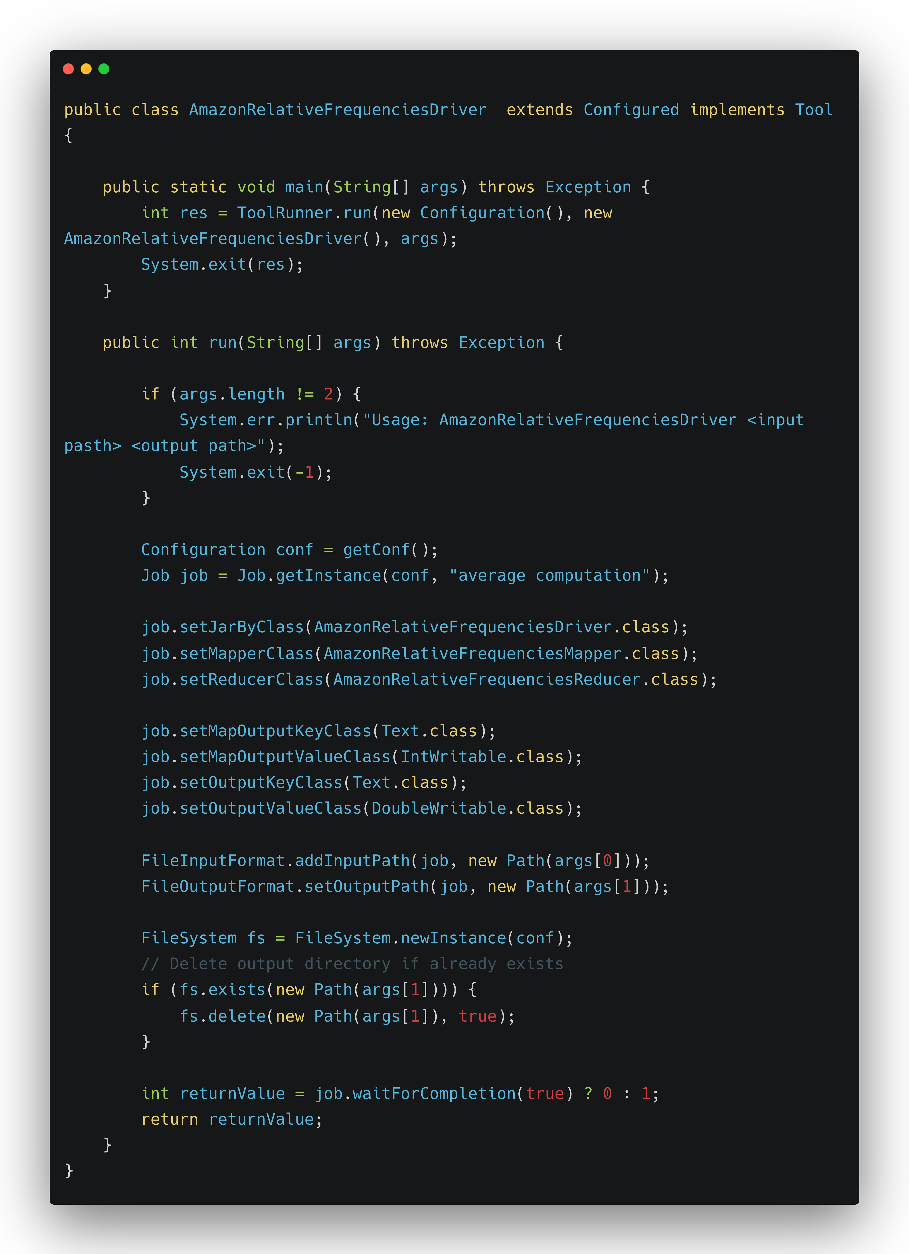
Pair Approach Driver

Slide 37
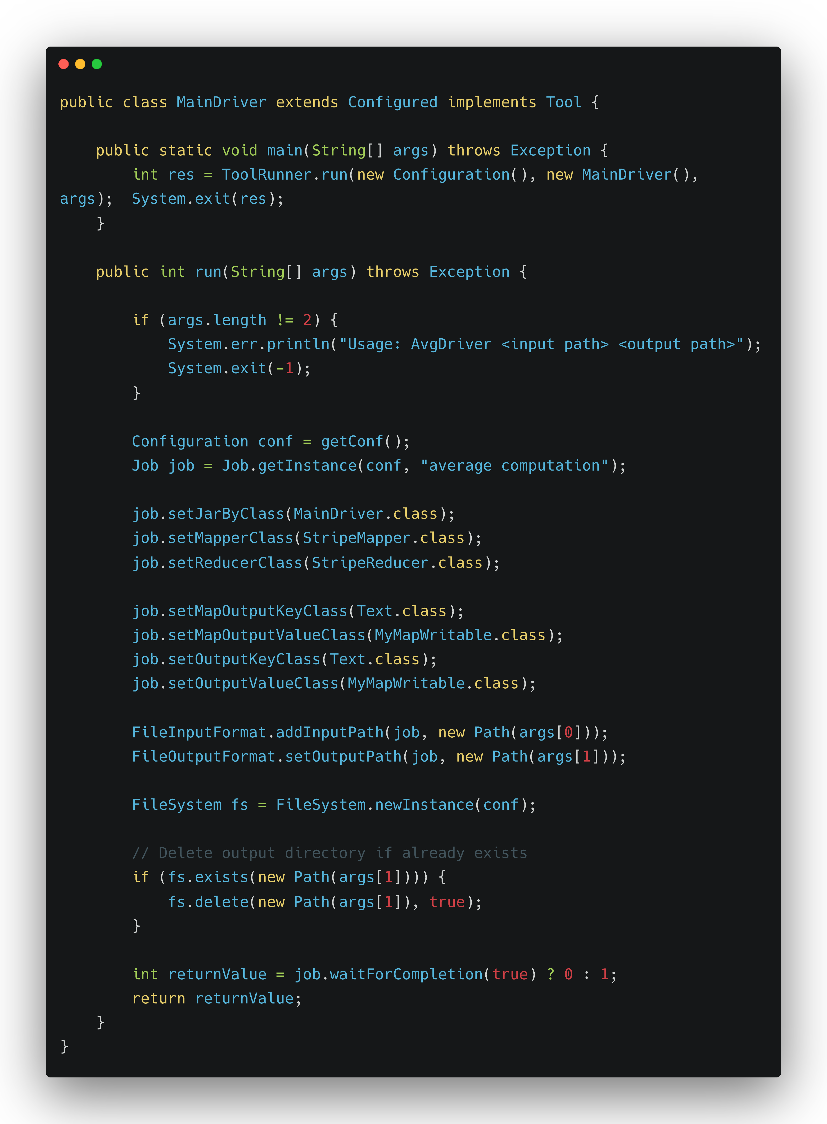
Stripe Approach Driver

